Slide 1


Advancing InfoSec Towards an Open, Shareable, Contributor-Friendly model of speeding InfoSec learning
John Lambert, @JohnLaTwC
Microsoft Threat Intelligence Center

Slide 2
If you want to go fast, go alone If you want to go far, go together African Proverb

Slide 3
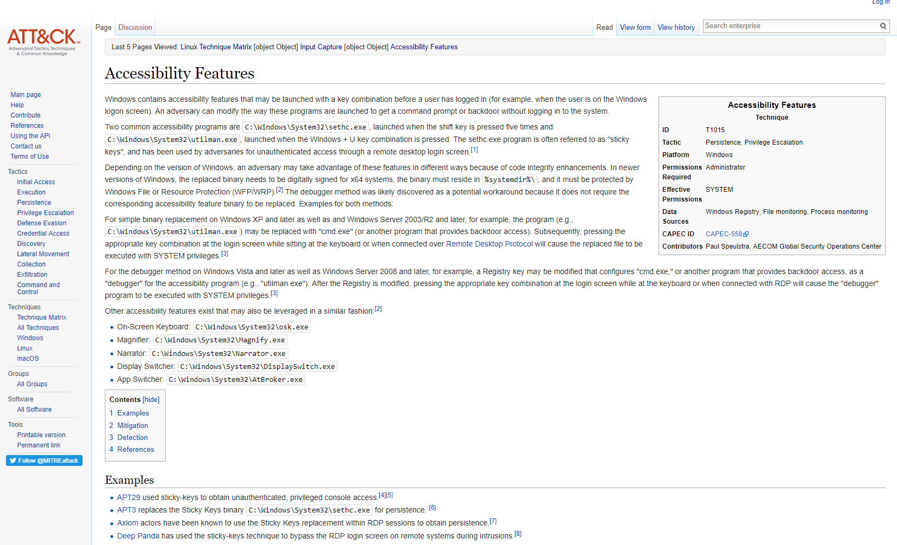

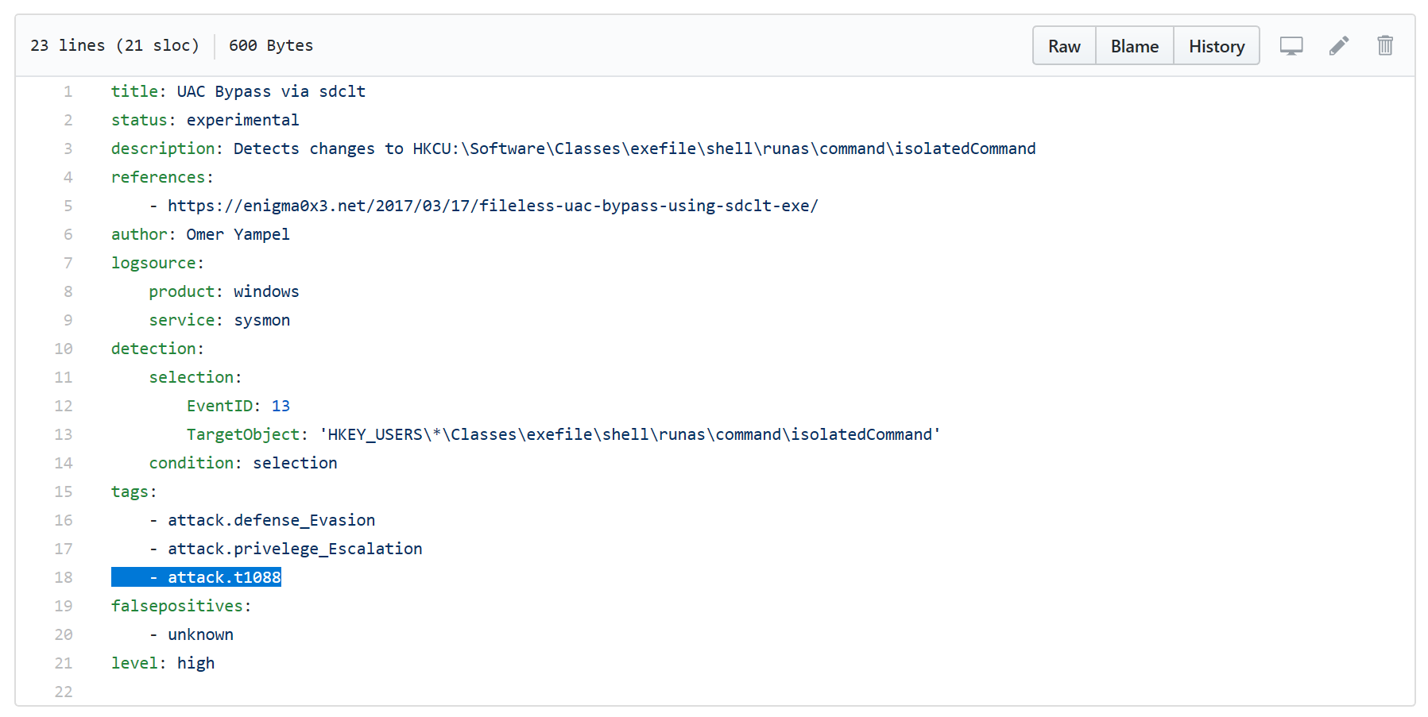

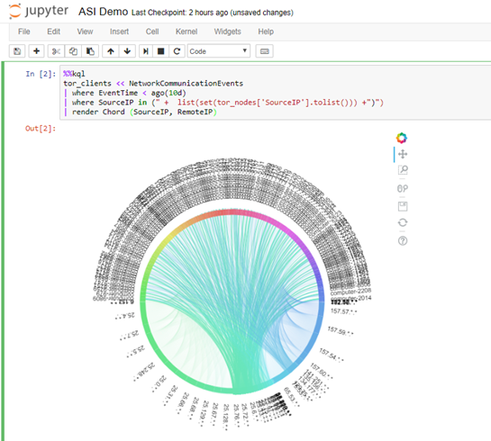

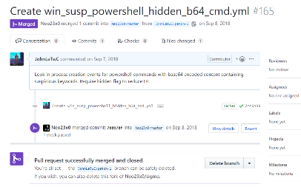


Organized Knowledge
How do understand new techniques and threats as a cohesive whole? How do you avoid each defender having to do this on their own?
Executable
Know-how
How do you translate insight into defensive action? How could you describe a new techniques and threats in a way that it is usable agnostic of environment?
Repeatable
Analysis
How do you make analysis repeatable, explainable and shareable? Can you share analytical expertise?
Promoting Community
All these elements exist because of a community. Technology is needed but learning cannot happen without teaching and teaching is built on contribution.

Slide 4
Organized Knowledge

Slide 5
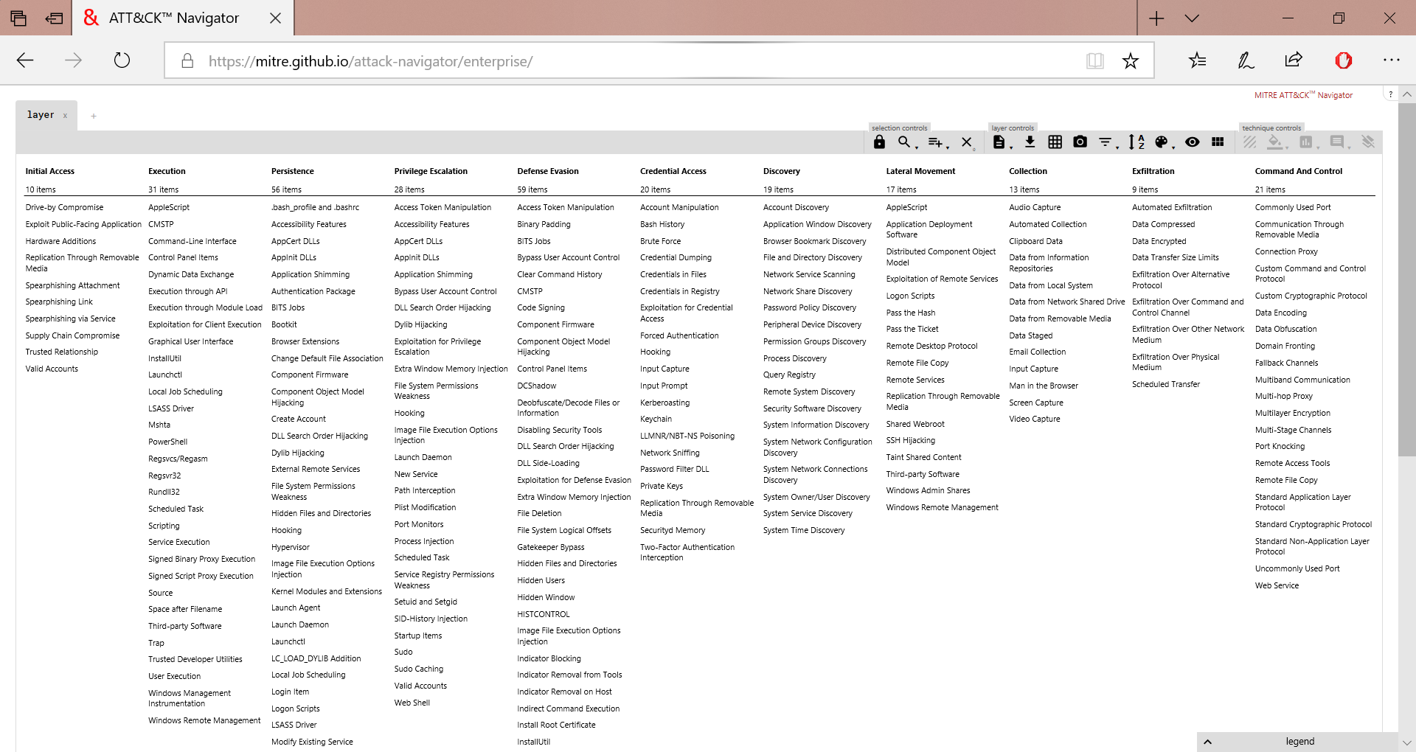
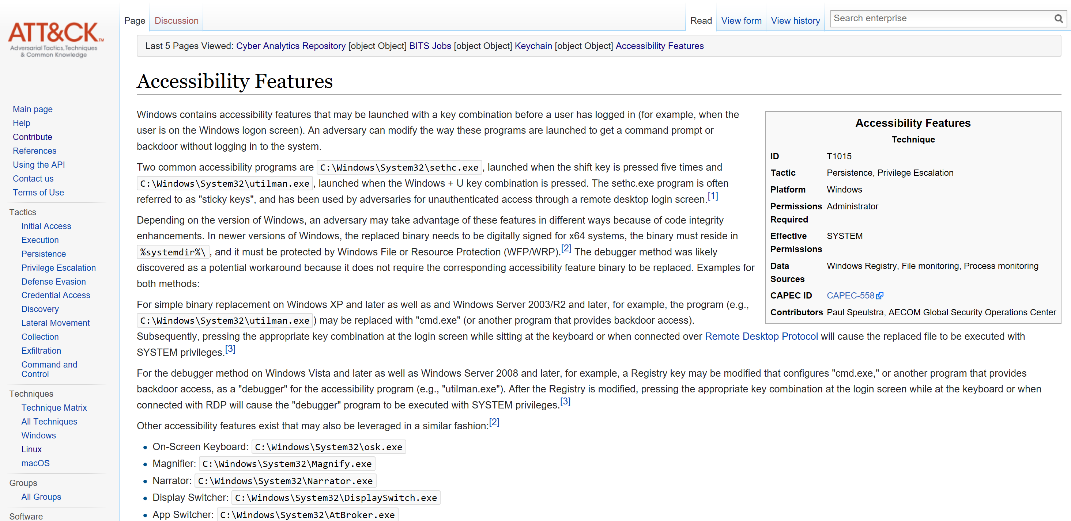
Knowledge

Slide 6
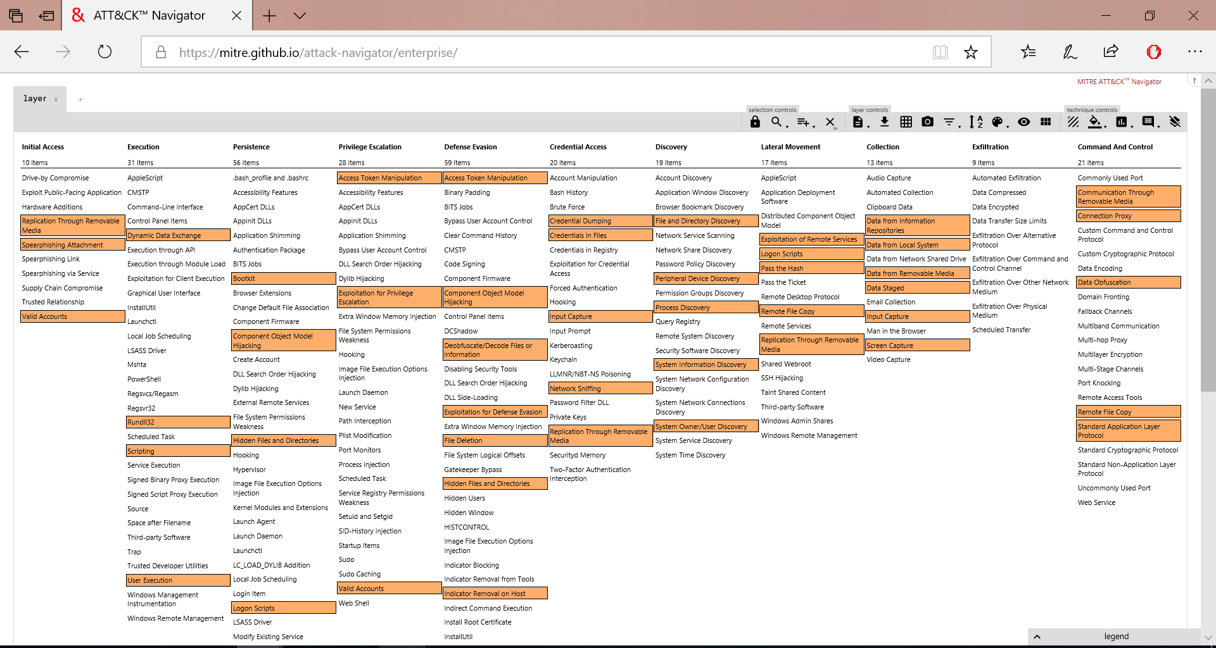
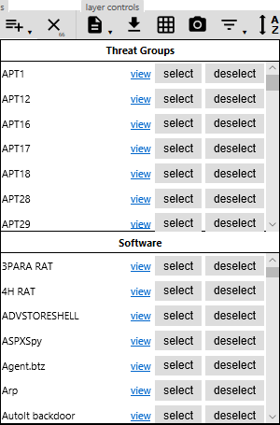

Slide 7
Knowledge
What about Cloud?

Slide 8
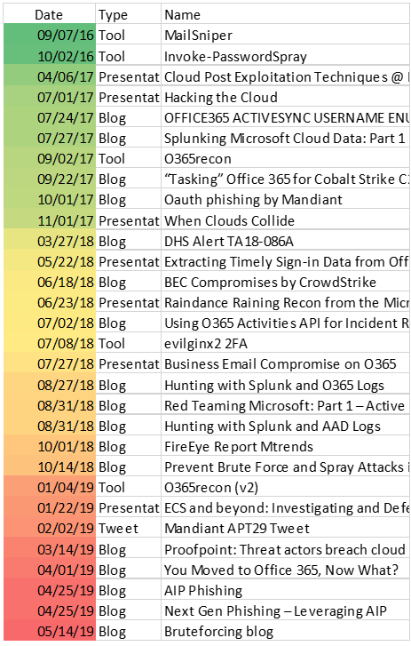
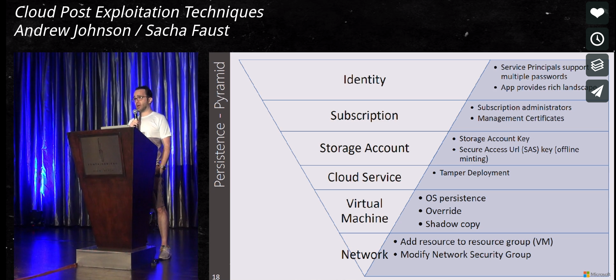
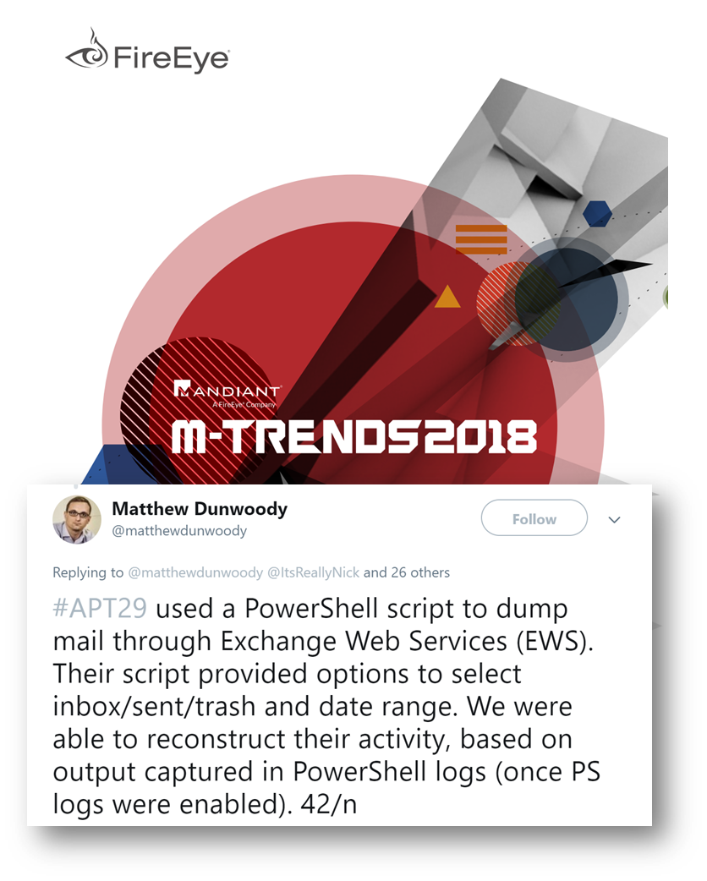
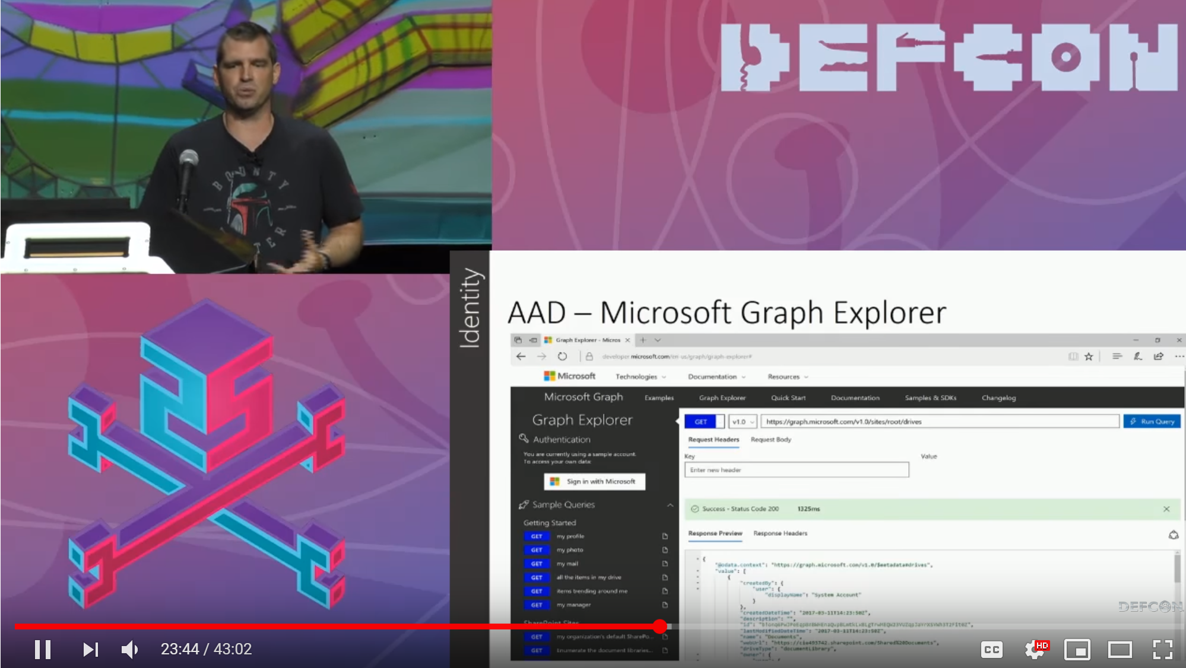
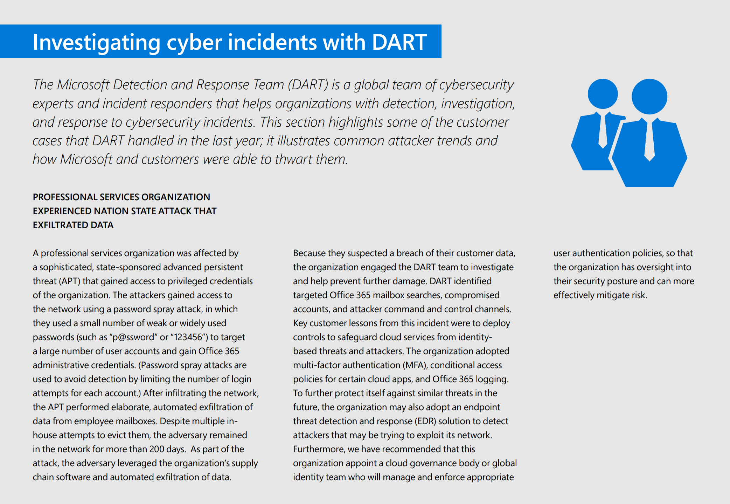
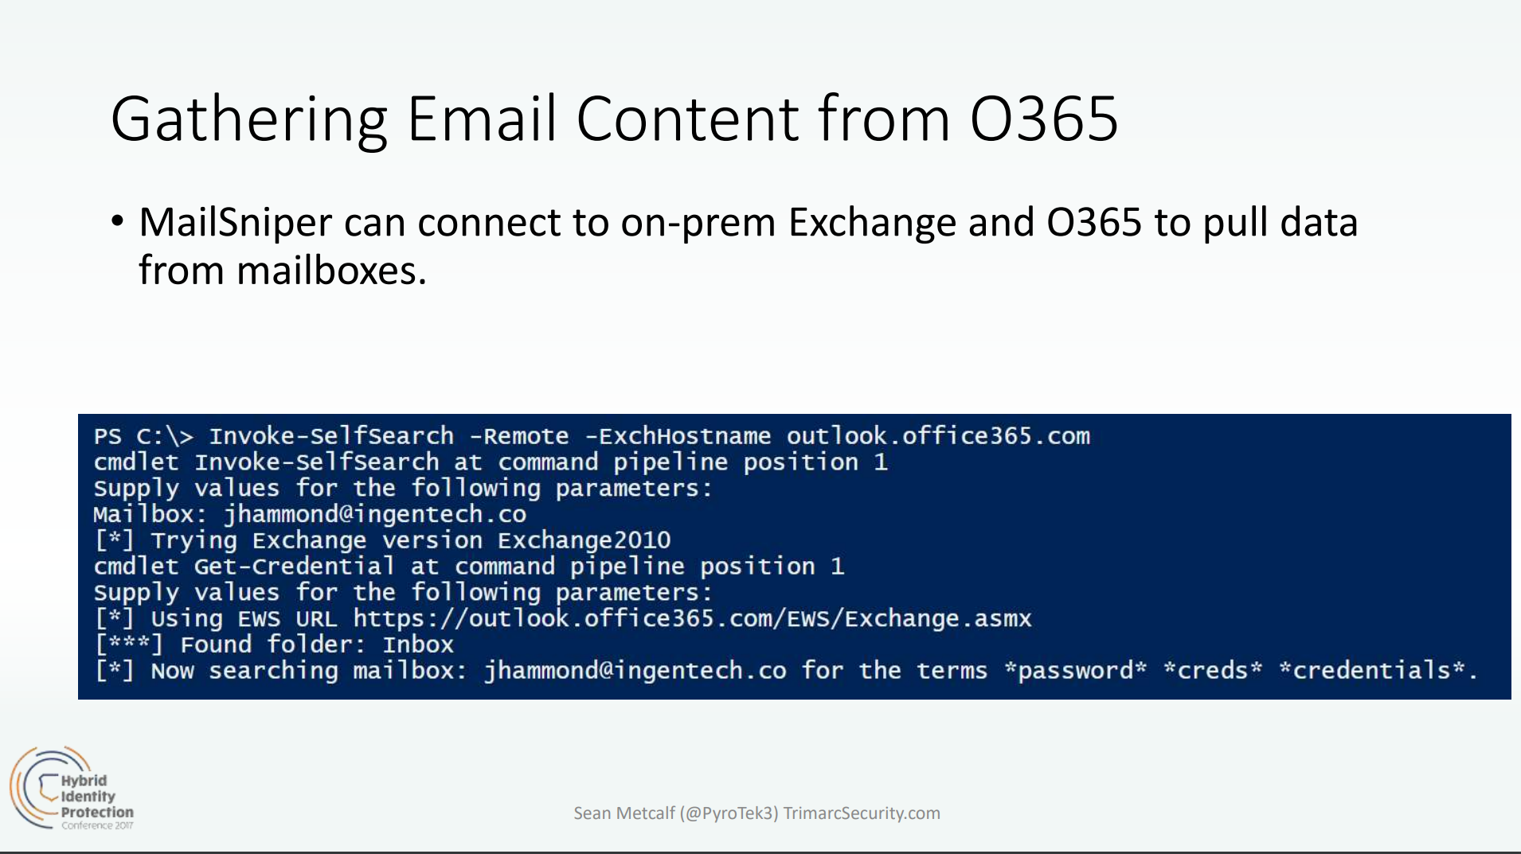
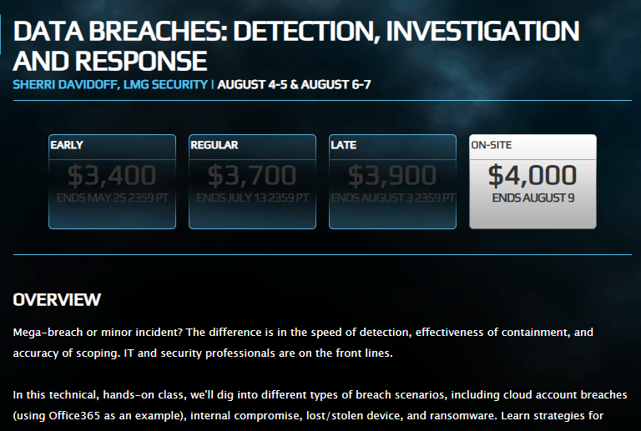

Researcher Interest in O365 Increasing
Presentations and Tools
Attacks
Cloud Post Exploitation Techniques @ Infiltrate 2017
“DEF CON 25 (2017) – Hacking the Cloud
Security in a Cloud-Enabled Environment
Blackhat 2018 Training
B-Sides 2019

Slide 9
Recon
Compromise
Persistence
Expansion
Actions on Intent
AAD | Dump users and groups with Azure AD | Password Spray: MailSniper Password Spray: CredKing
O365 | Get Global Address List: MailSniper Find Open Mailboxes: MailSniper User account enumeration with ActiveSync Harvest email addresses Verify target is on O365, [DNS], [urls], [list], [getuserrealm] Enumerate usernames, 2FA status via ActiveSync [o365userenum] Role, group, admin enumeration with Get-MsolRoleMember [RainDance] | Bruteforce of Autodiscover: SensePost Ruler Phishing for credentials Phishing using OAuth app 2FA MITM Phishing: evilginx2 [github] Use AIP to manage attack campaign | Add Mail forwarding rule Add Global Admin Account Delegate Tenant Admin | MailSniper: Search Mailbox for credentials Search for Content with eDiscovery Account Takeover: Add-MailboxPermission Pivot to On-Prem host: SensePost Ruler Exchange Tasks for C2: MWR Send Internal Email | MailSniper: Search Mailbox for content Search for Content with eDiscovery Exfil email using EWS APIs with PowerShell Download documents and email Financial/wire fraud
End Point | Search host for Azure credentials: SharpCloud |  | Persistence through Outlook Home Page: SensePost Ruler Persistence through custom Outlook Form Create Hidden Mailbox Rule [tool]
On-Prem Exchange | Portal Recon Enumerate domain accounts using Skype4B, [LyncSmash] Enumerate domain accounts: OWA & Exchange Enumerate domain accounts: OWA: FindPeople OWA version discovery | Password Spray using Invoke-PasswordSprayOWA, EWS, Atomizer Bruteforce of Autodiscover: SensePost Ruler PasswordSpray Lync/S4B [LyncSniper] | Exchange MTA | Search Mailboxes with eDiscovery searches (EXO, Teams, SPO, OD4B, Skype4B) Delegation
Prepared by @JohnLaTwC, May 2019, v1.07

Slide 10
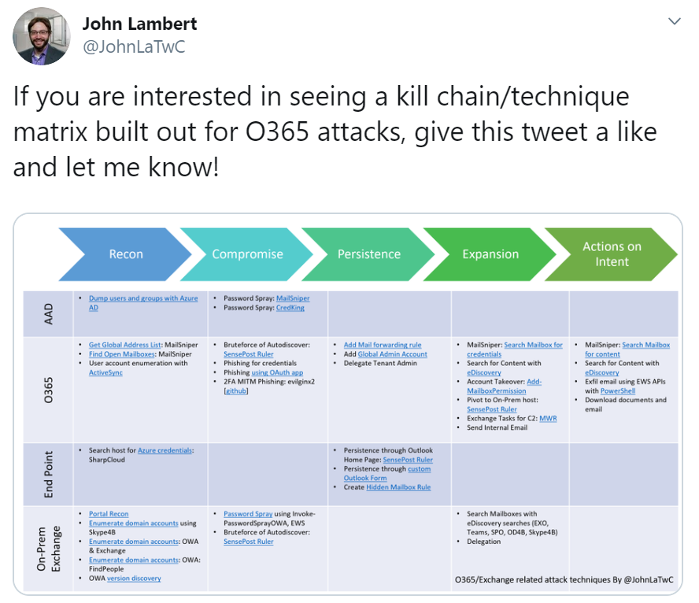
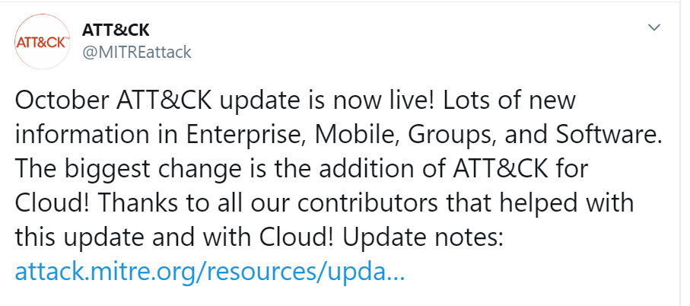
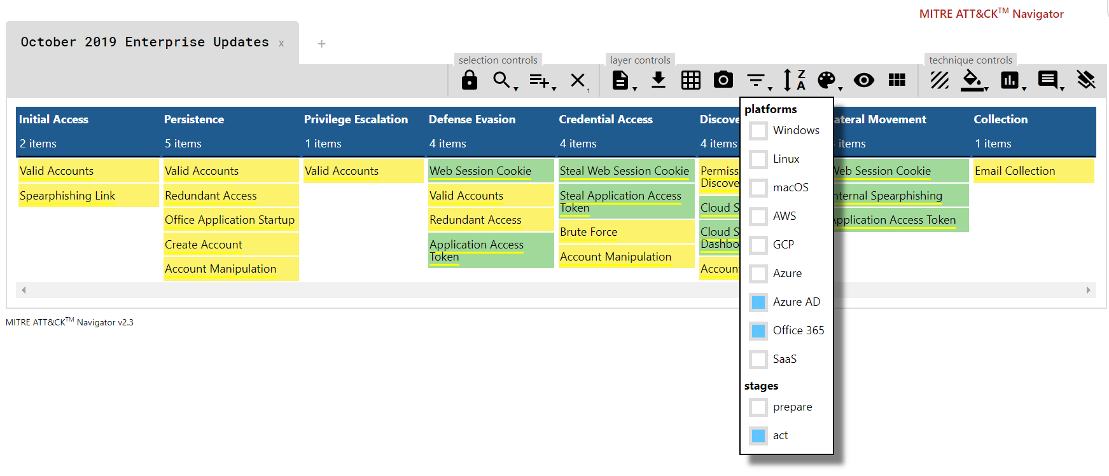
MITRE ATT&CK Additions for Cloud

Slide 11
Executable Know-how

Slide 12
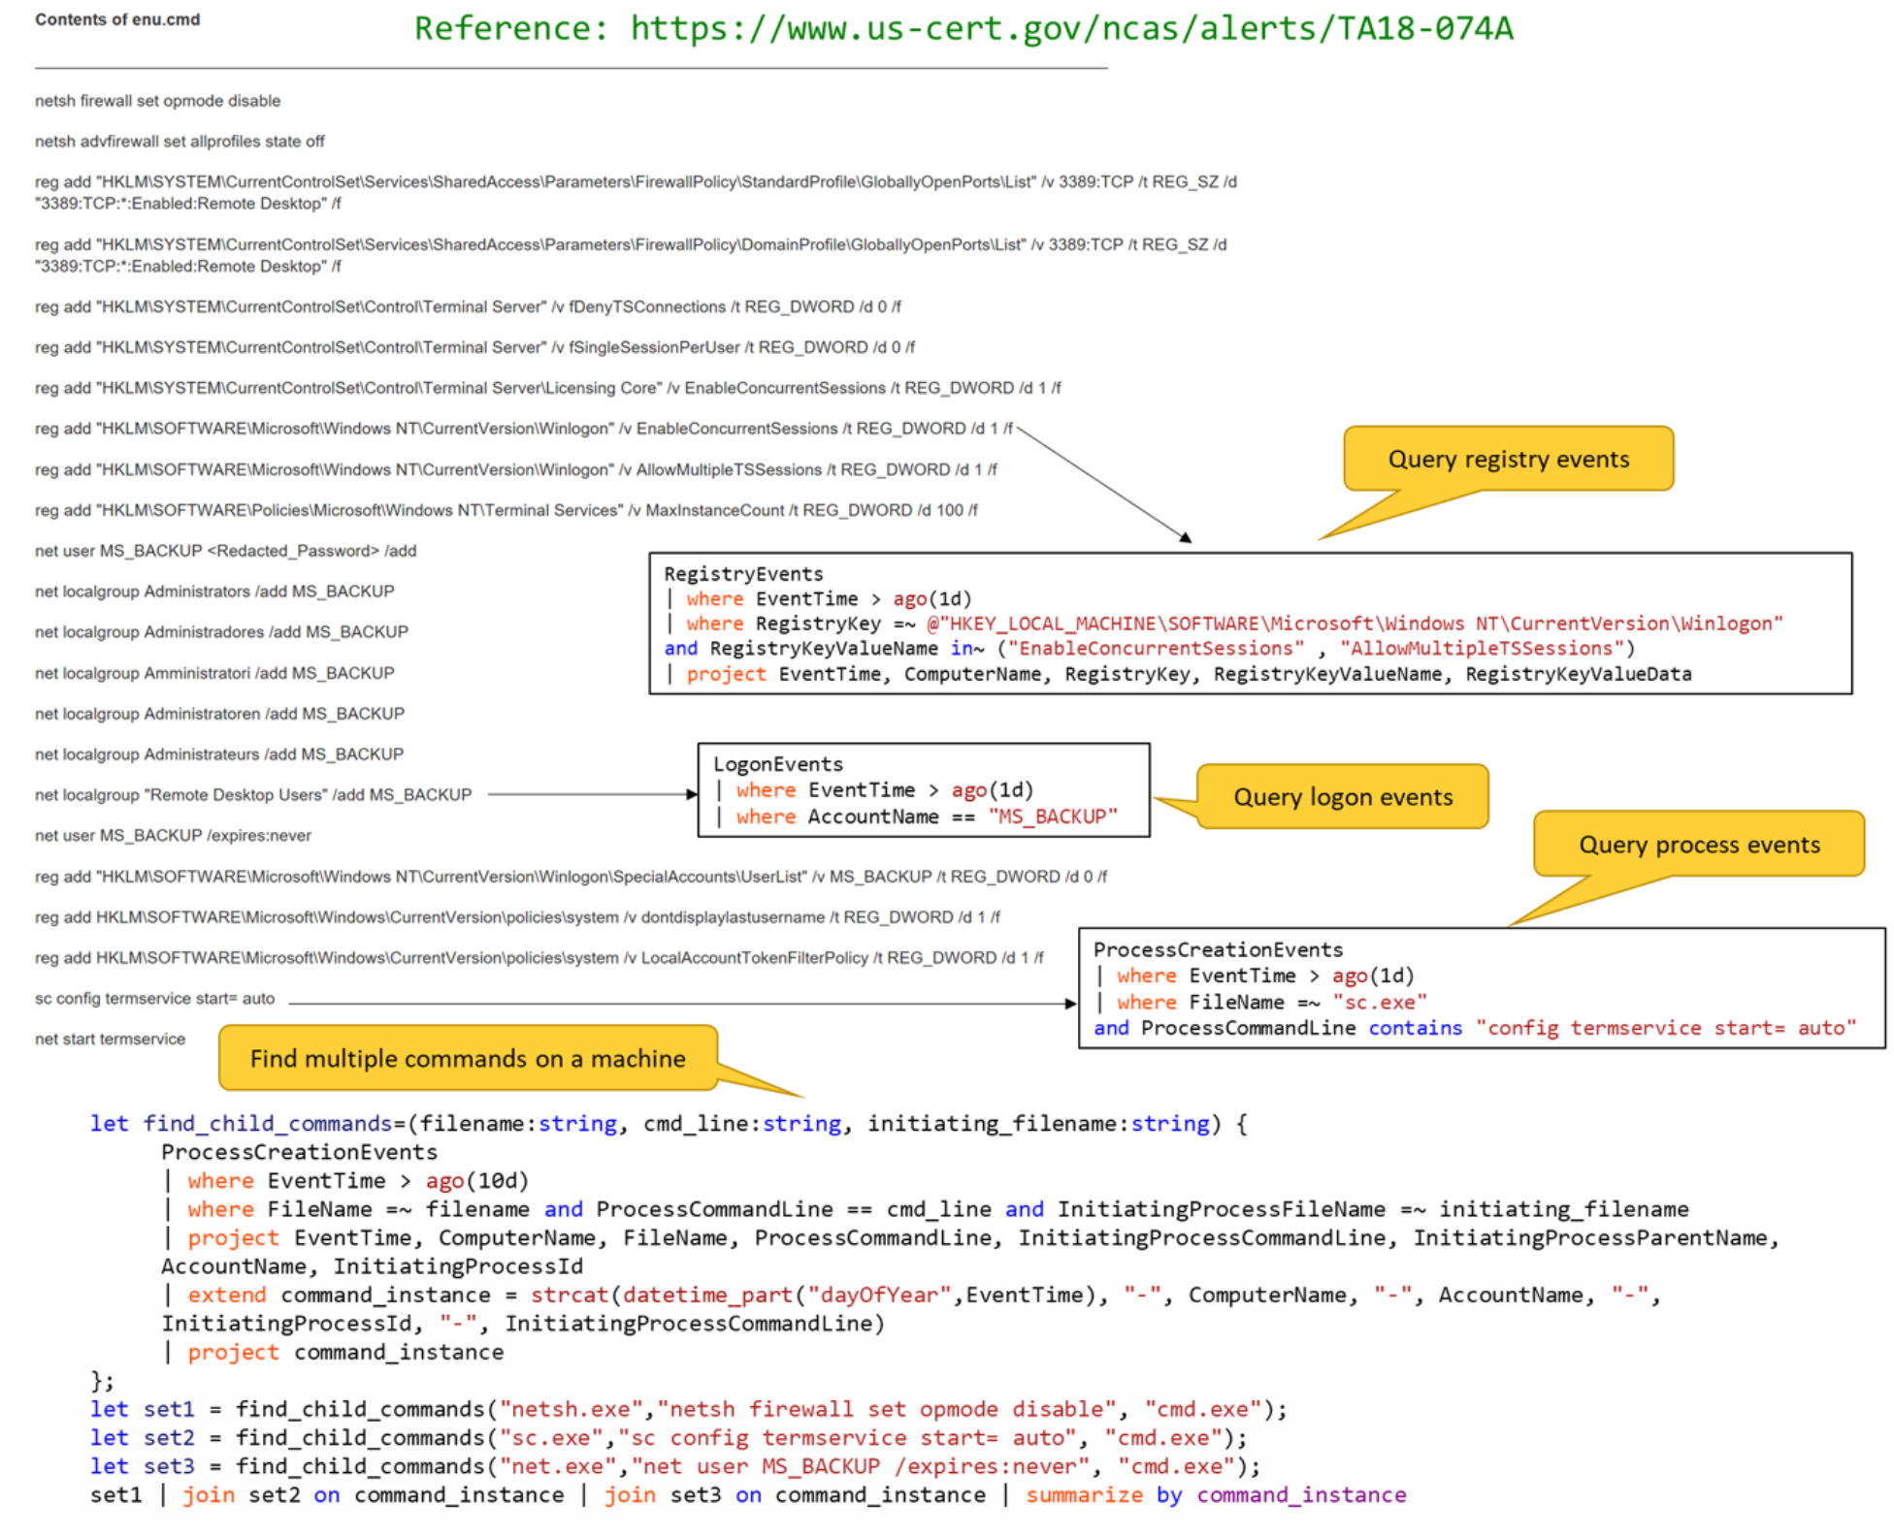
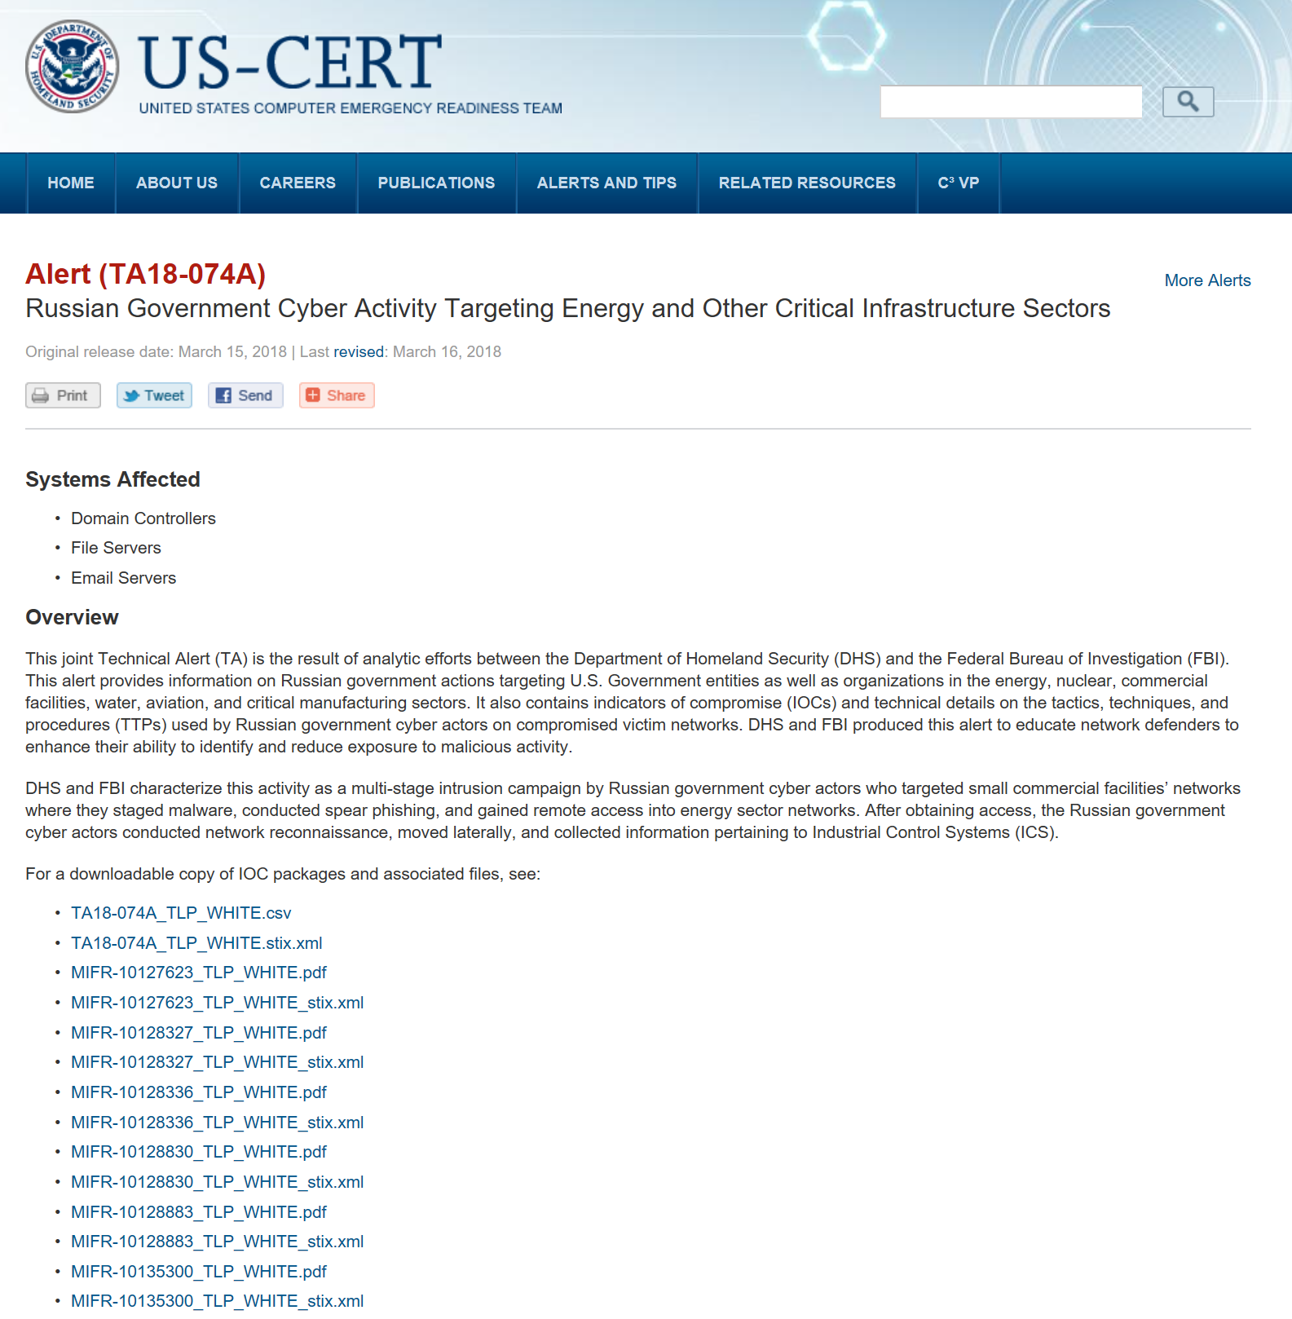
Automating Advisories

Slide 13
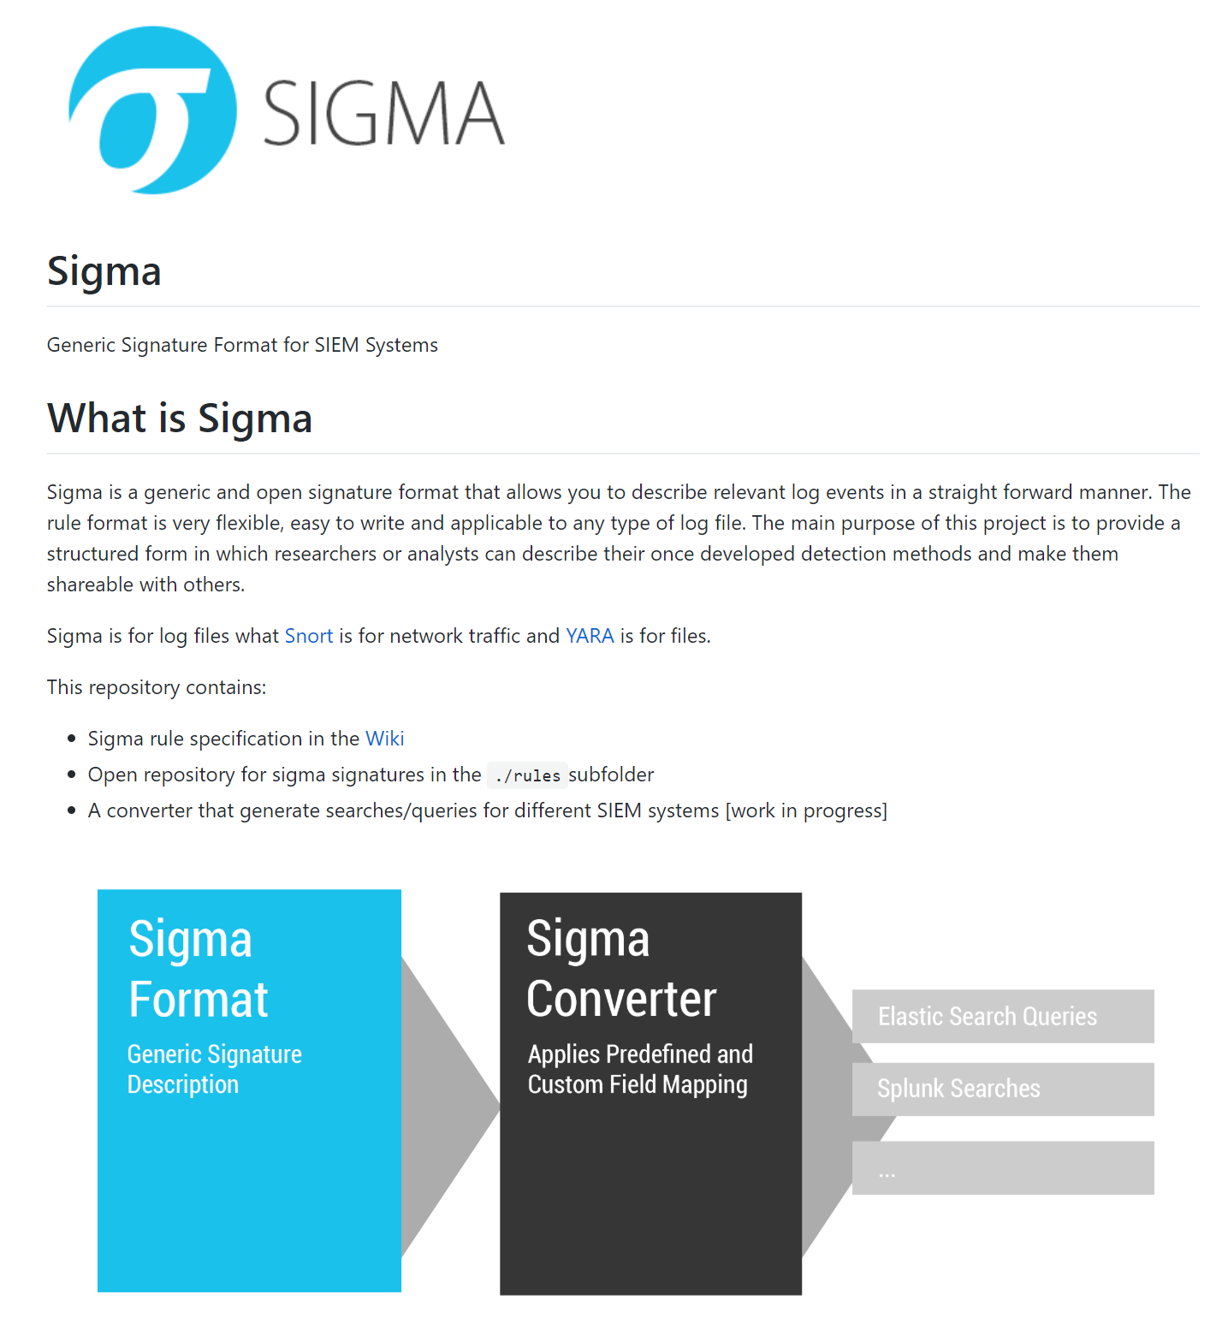
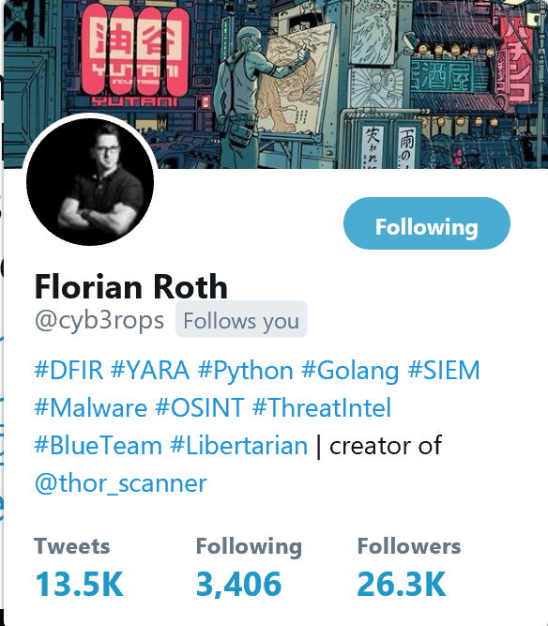

Slide 14
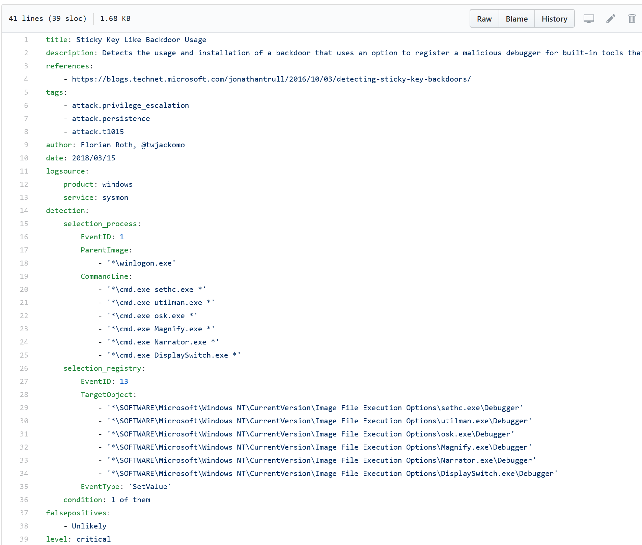
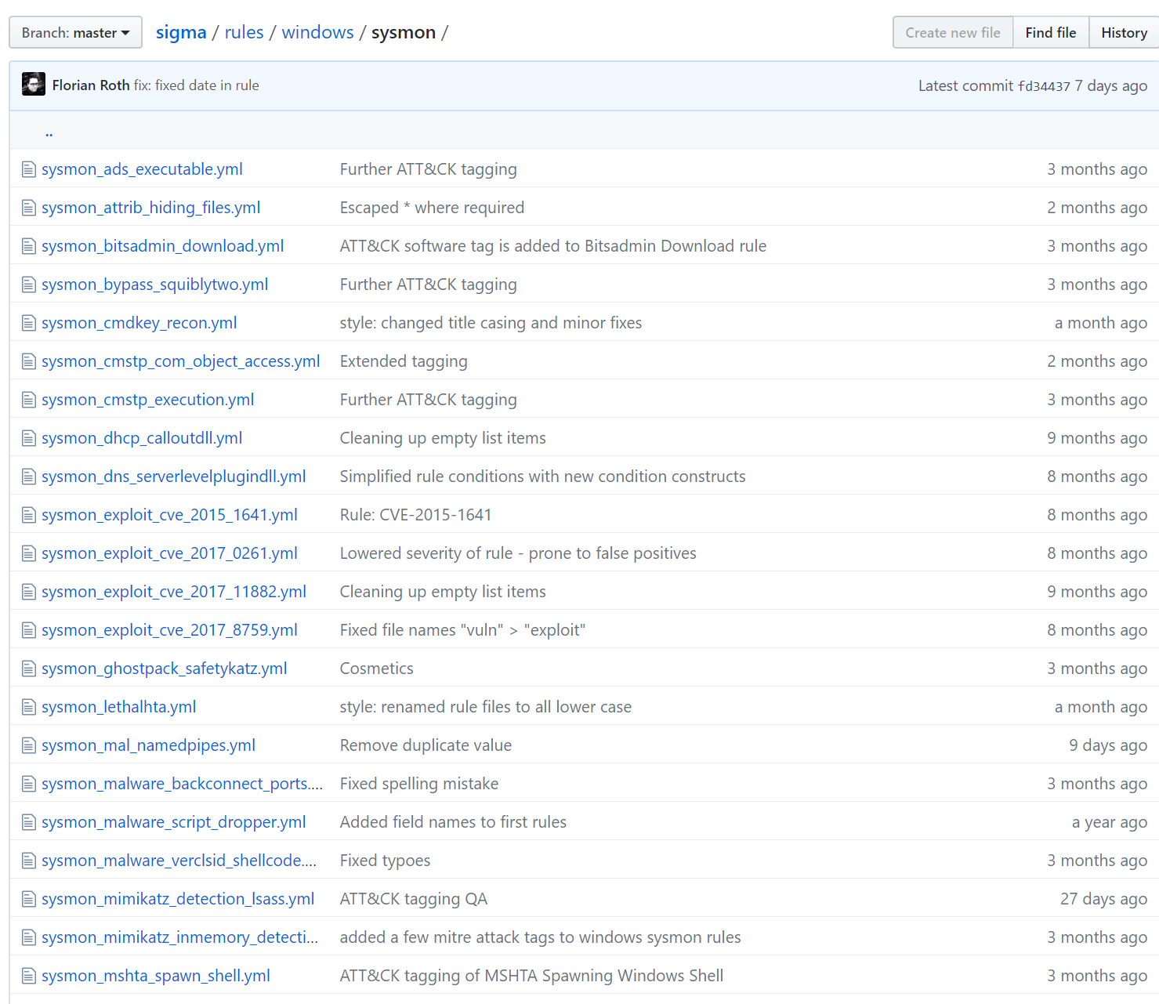
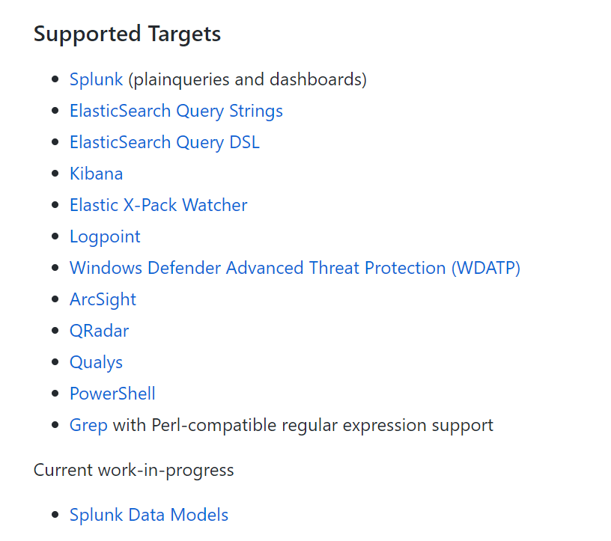

Slide 15
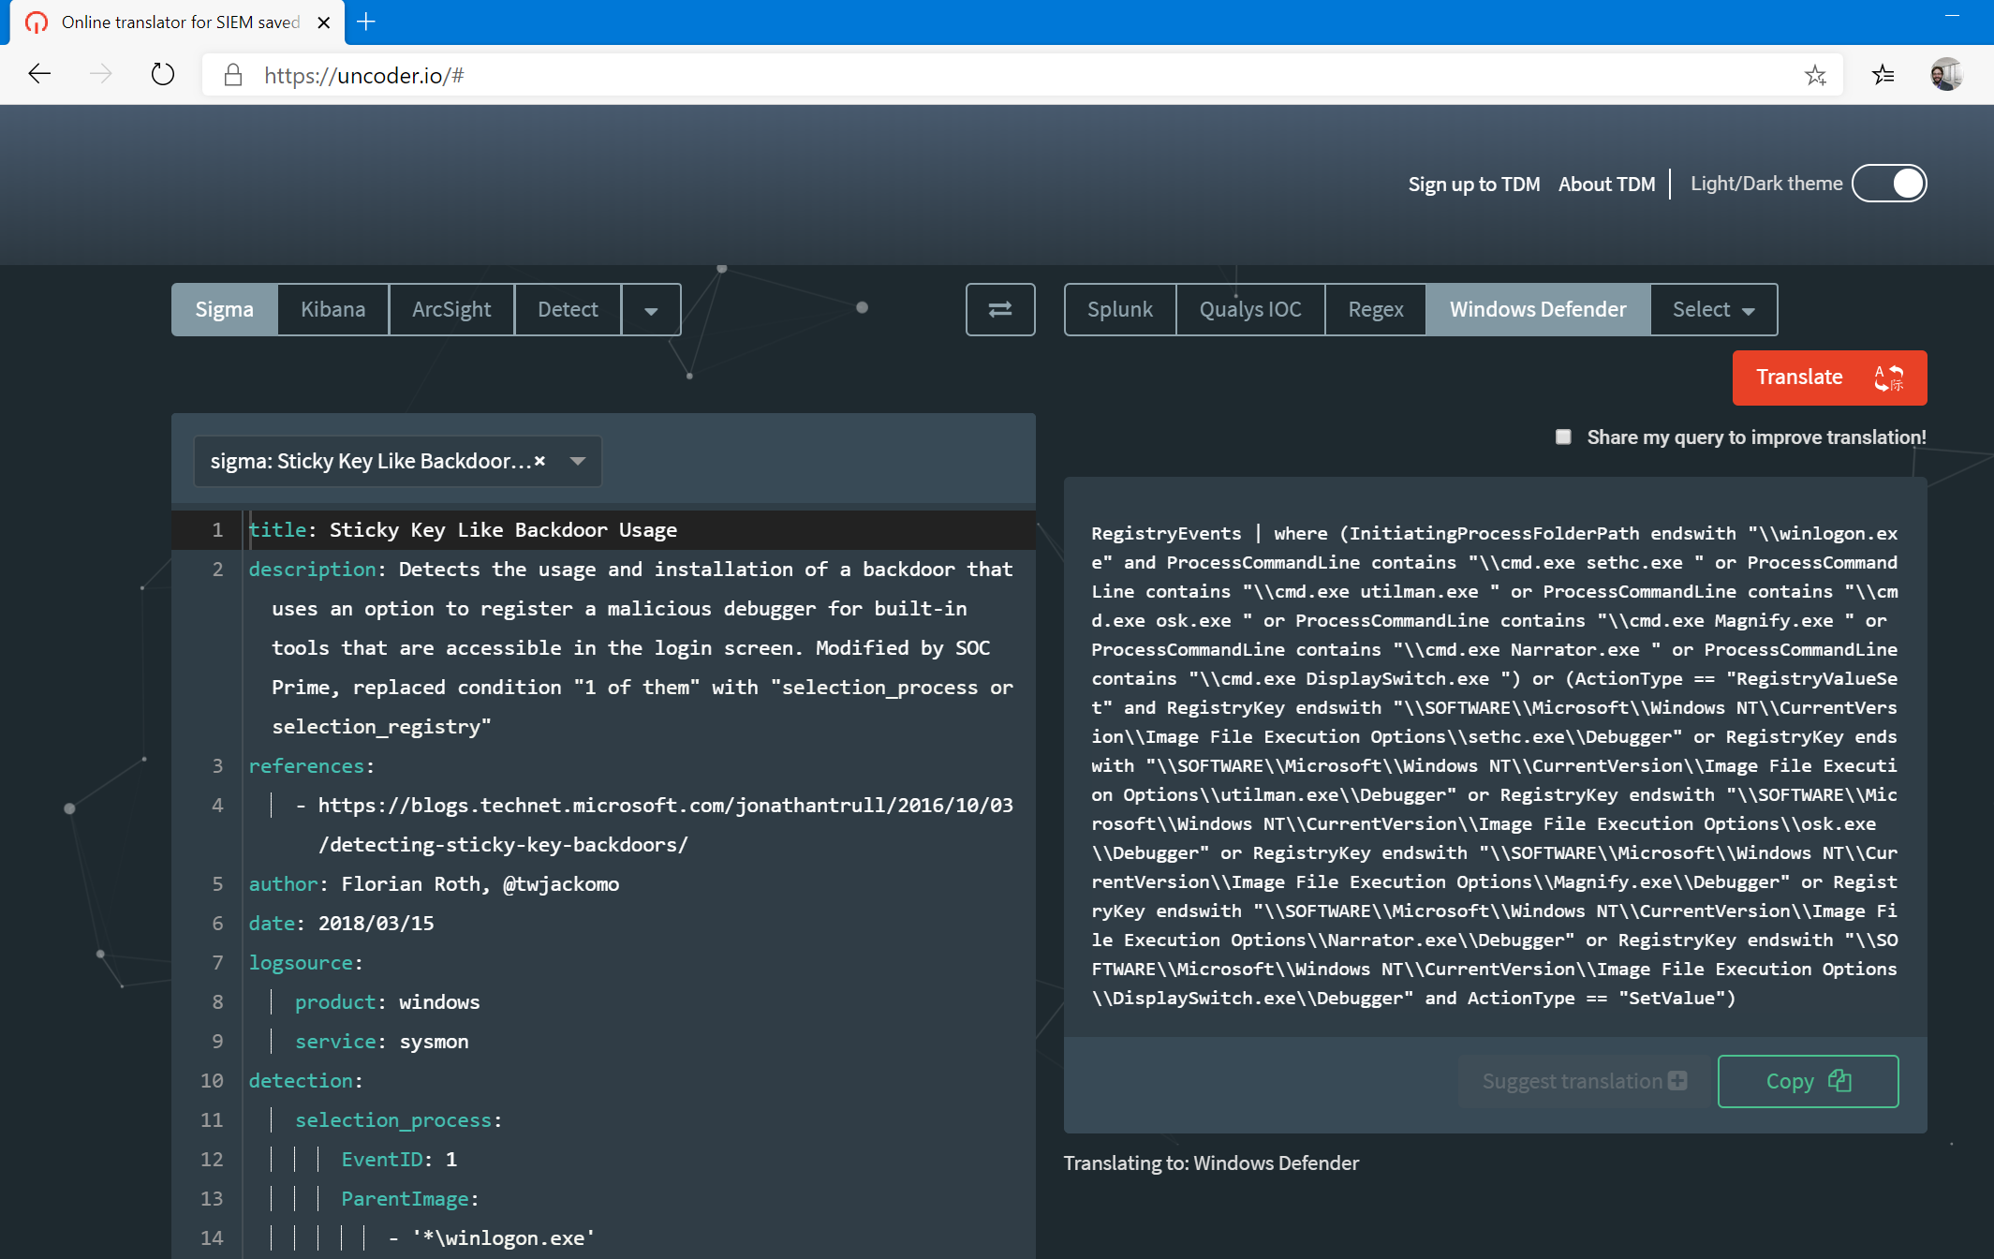
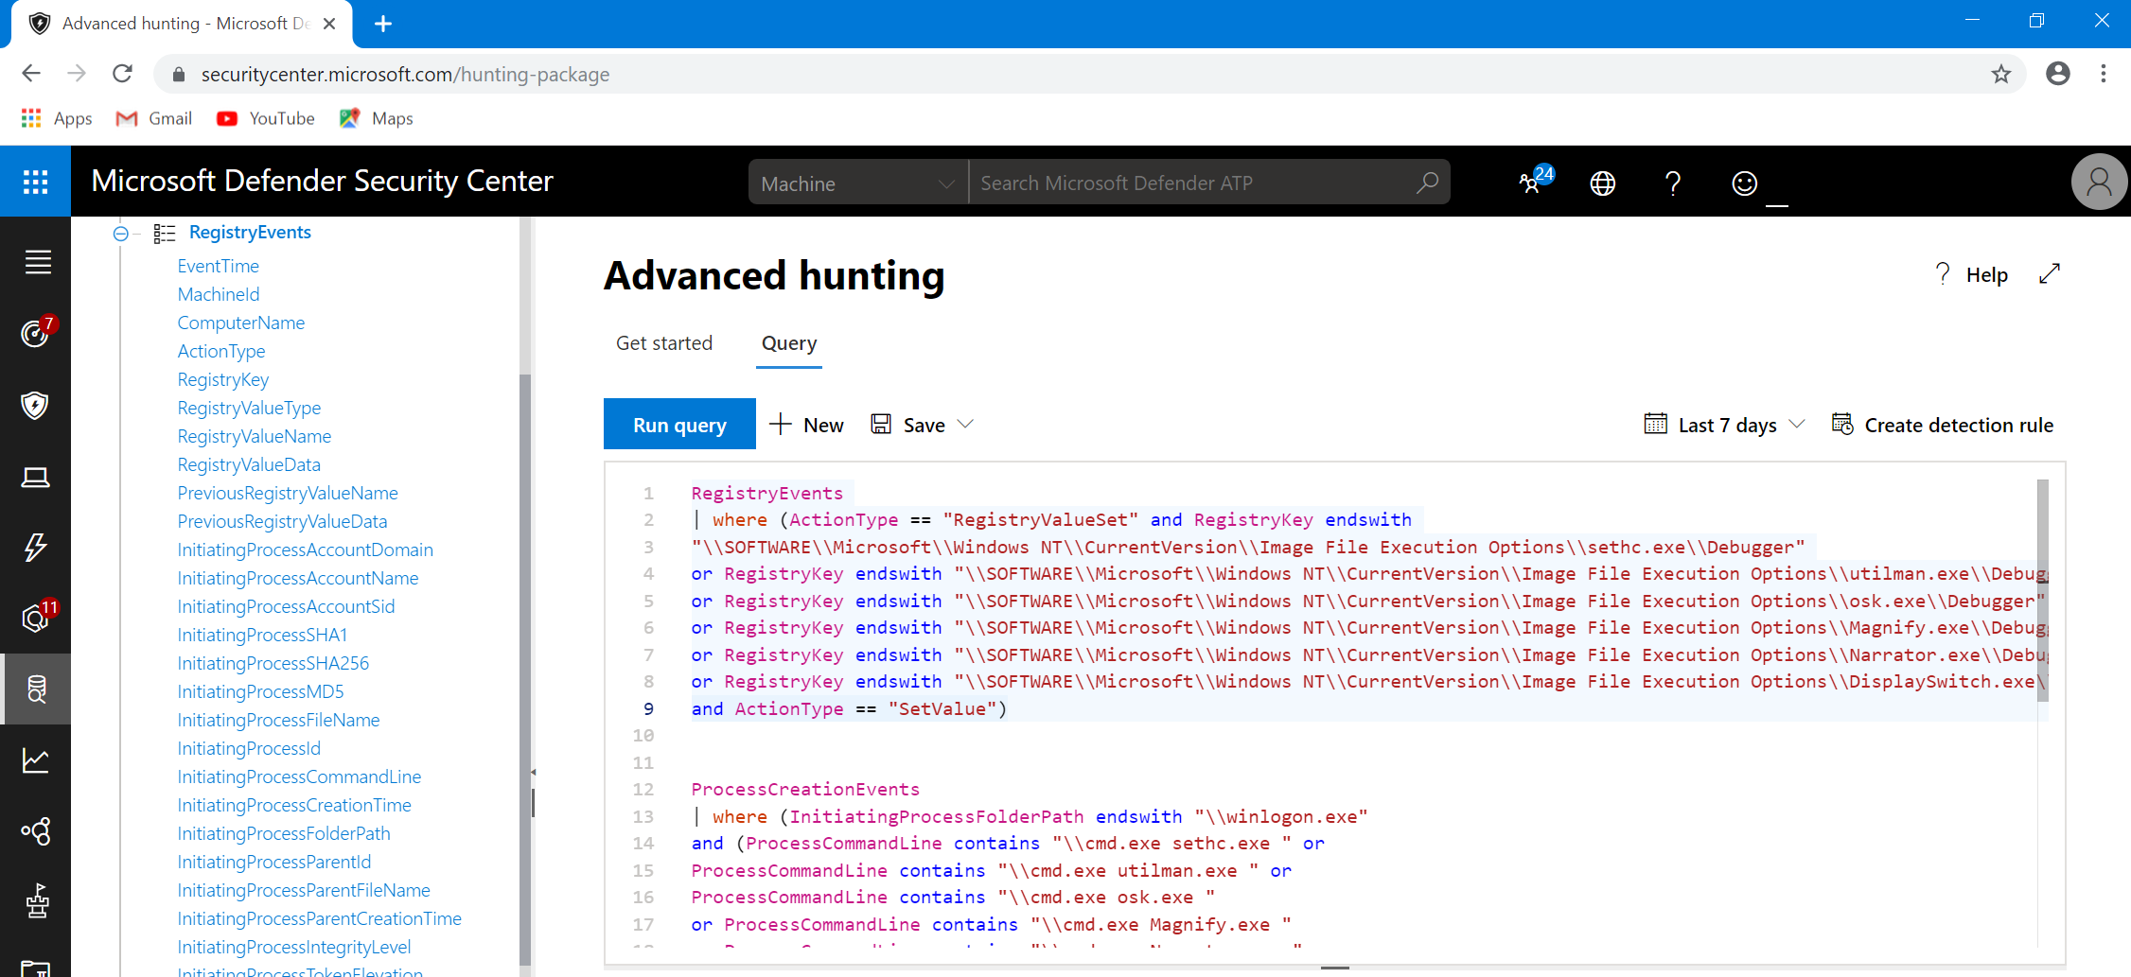
Translation

Slide 16
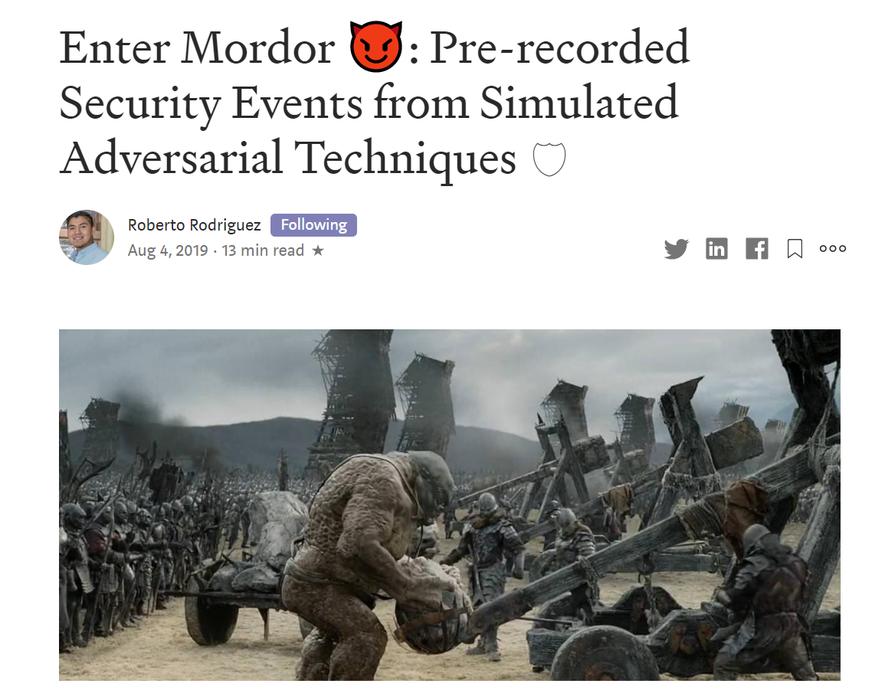
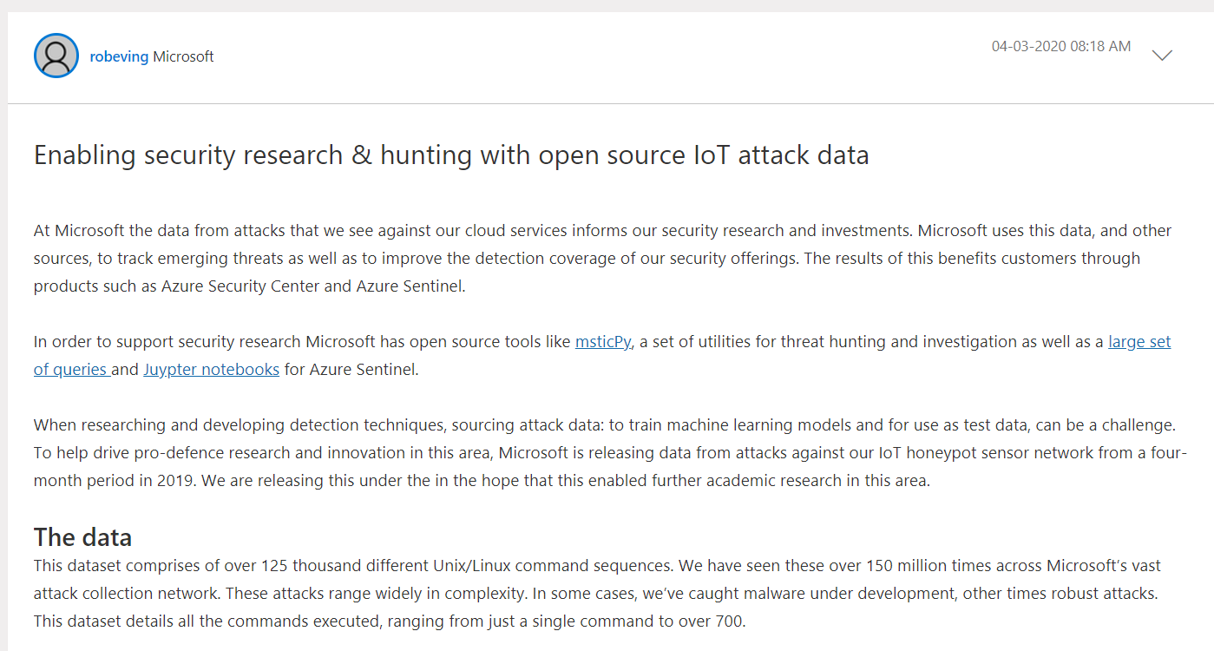

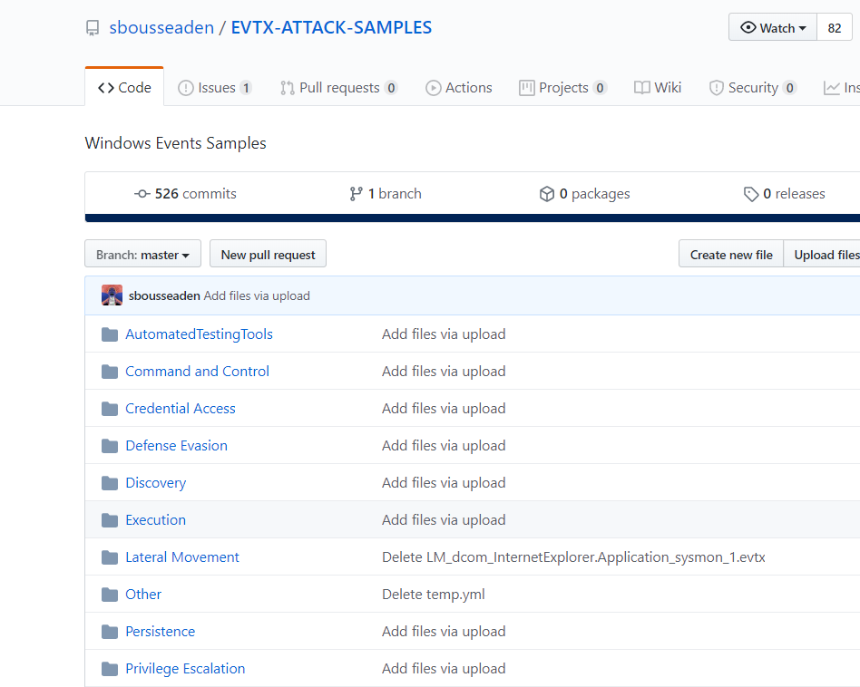
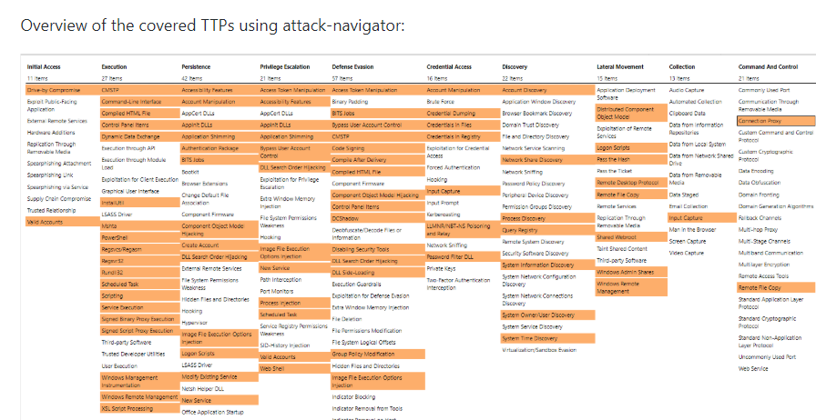
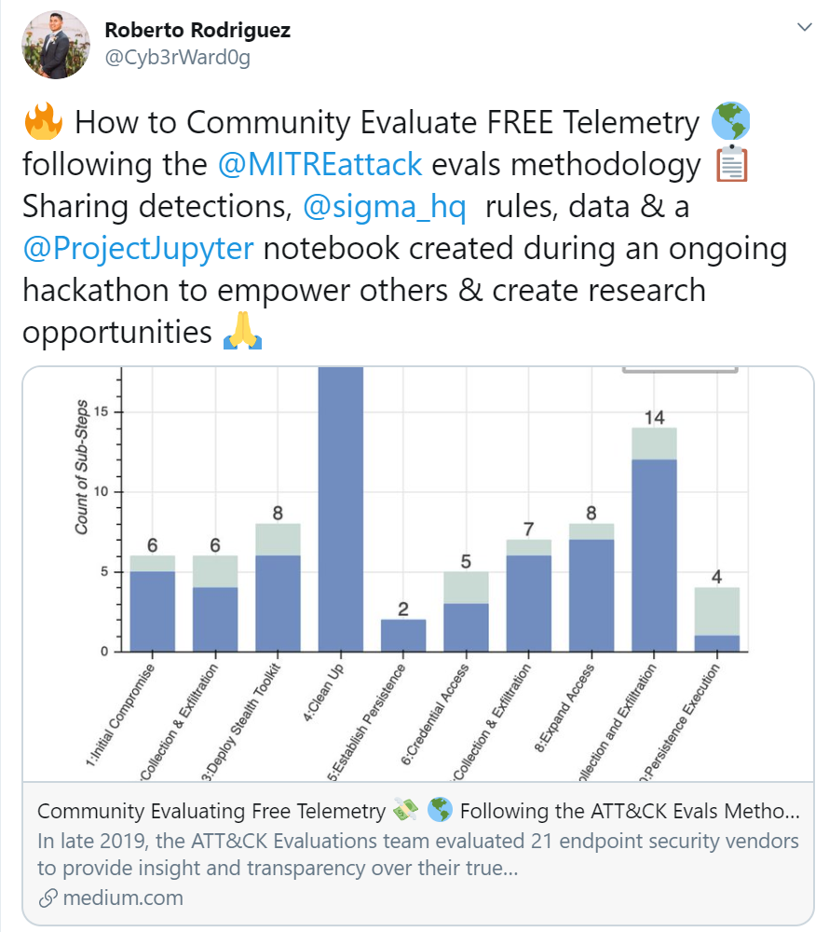
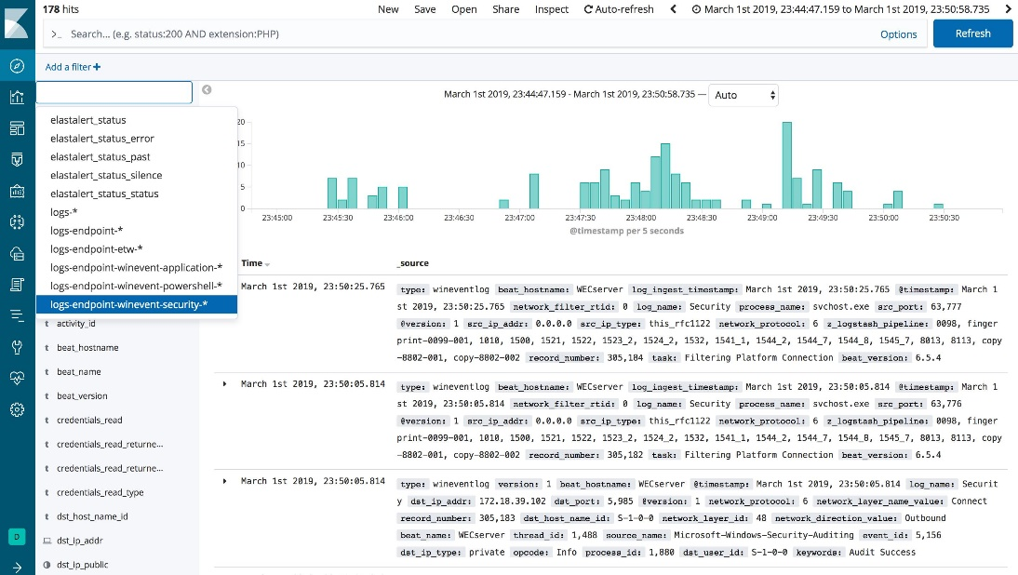
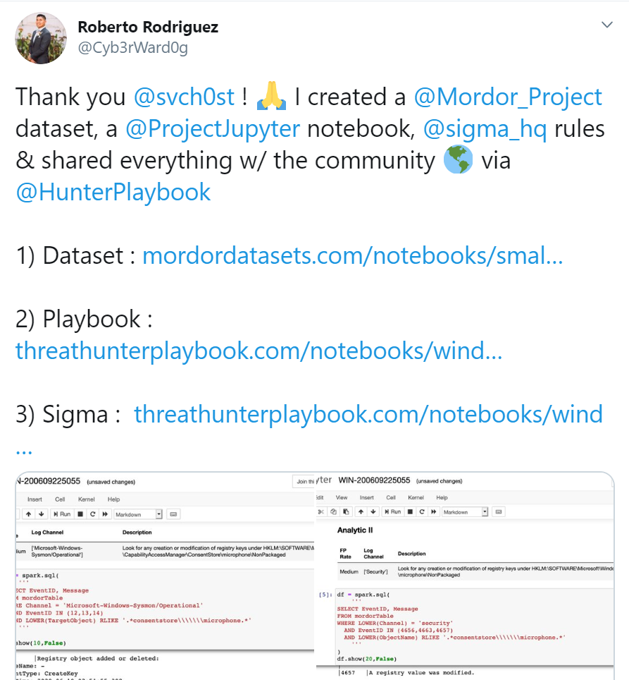
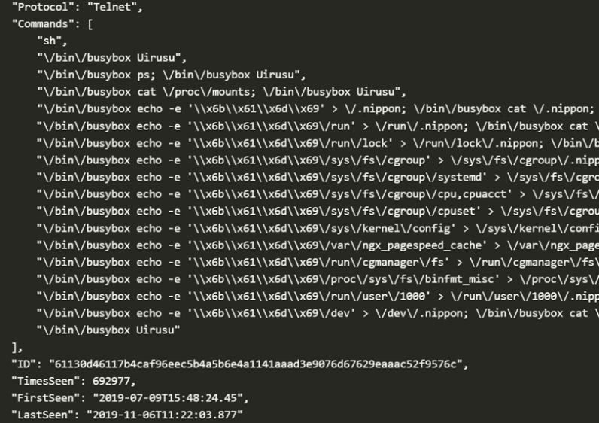
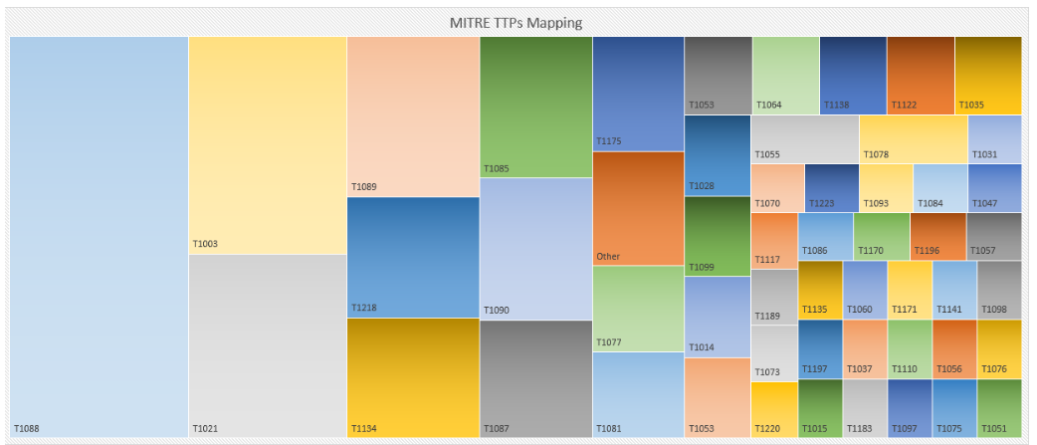
Open Source Data Sets

Slide 17
Repeatable Analysis

Slide 18
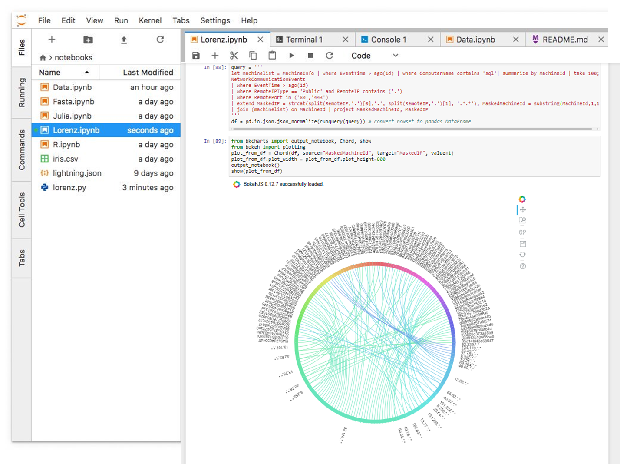
Jupyter

Slide 19
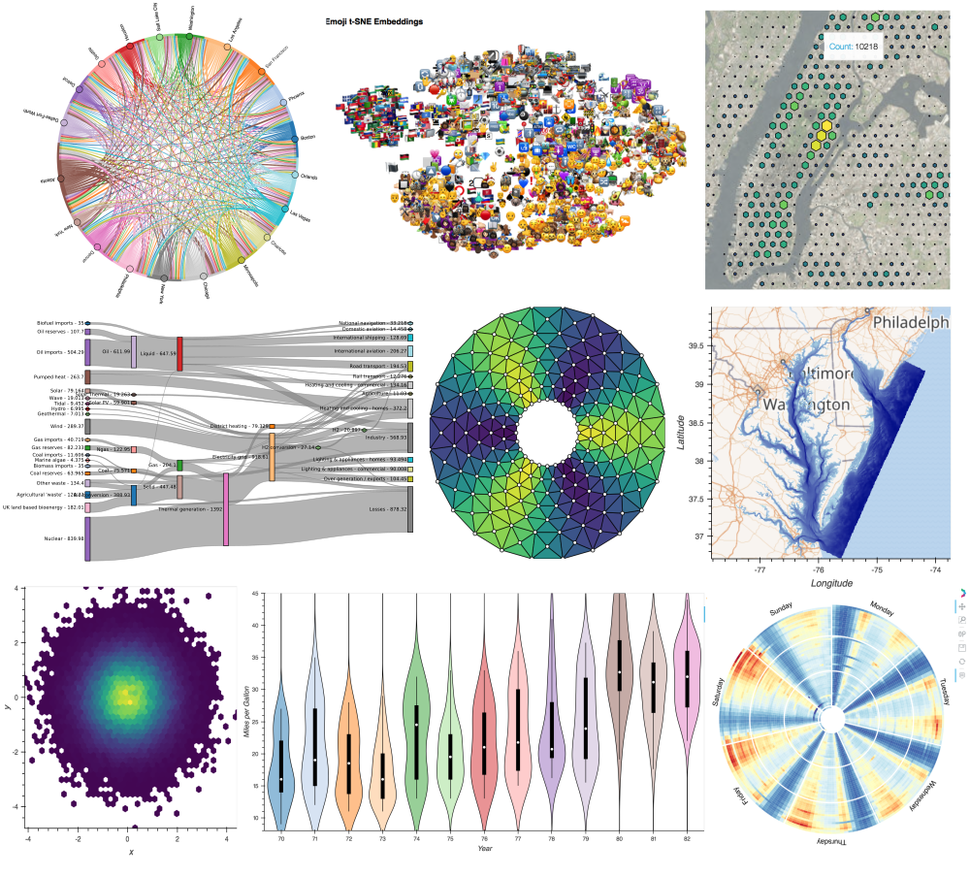
Jupyter Notebooks
Vibrant ecosystem
2.6 million notebooks on GitHub
Local and Cloud supported:
Azure Sentinel
Azure Notebooks
AWS SageMaker
Google Data Lab
Shareable
Re-runnable
Extensible

Slide 20
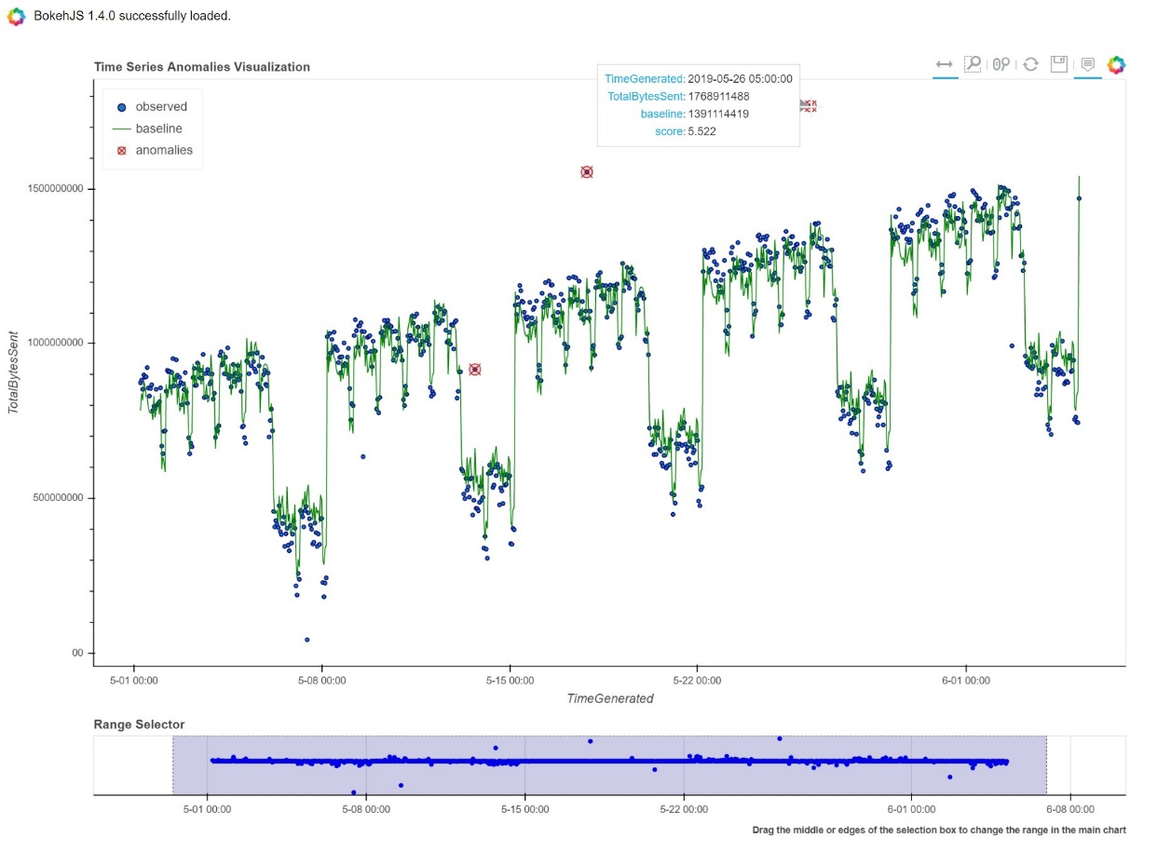
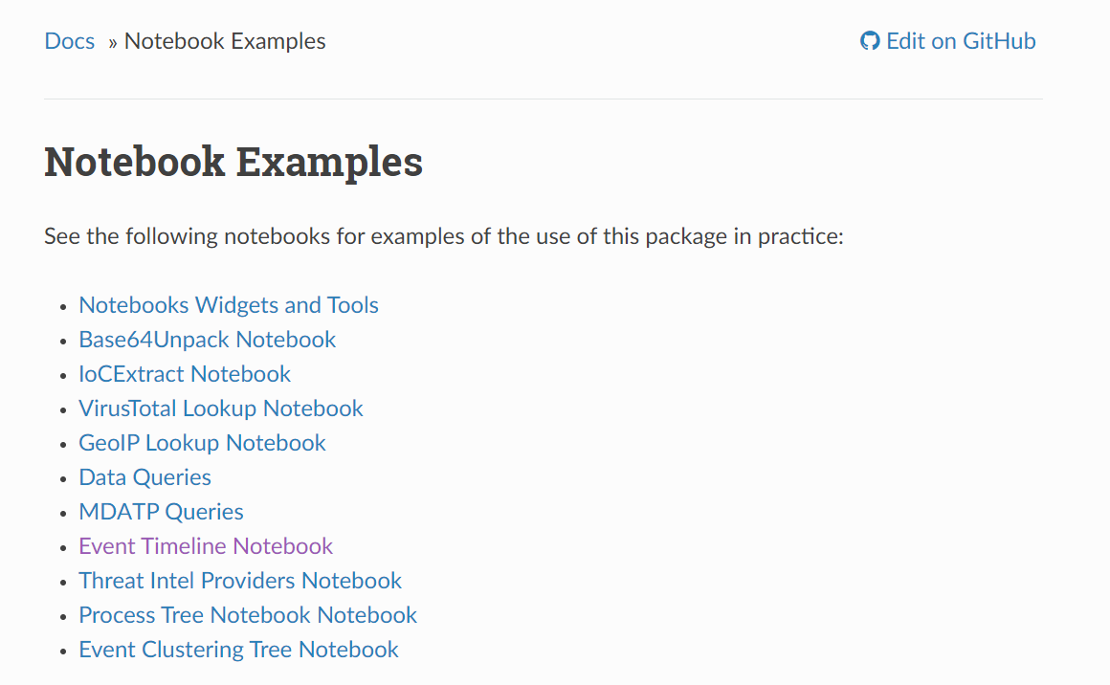
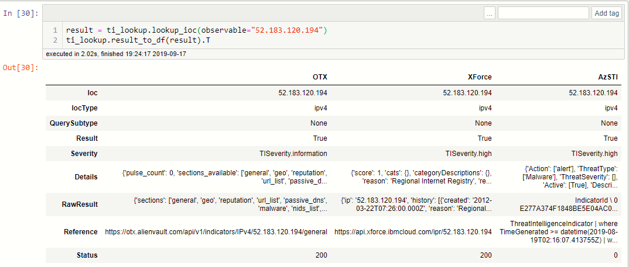
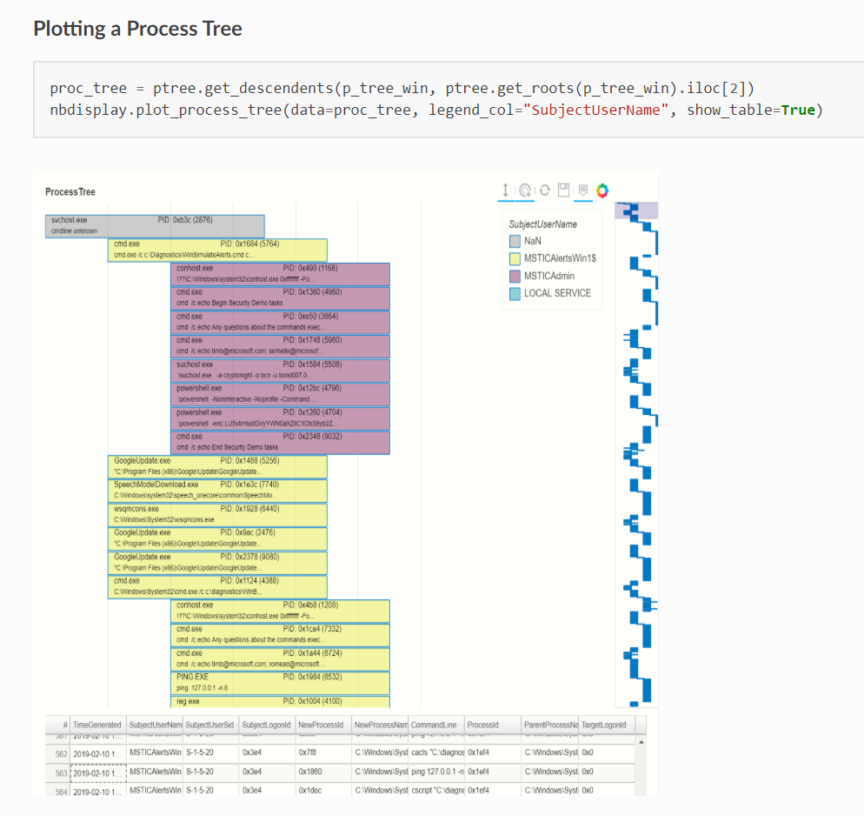
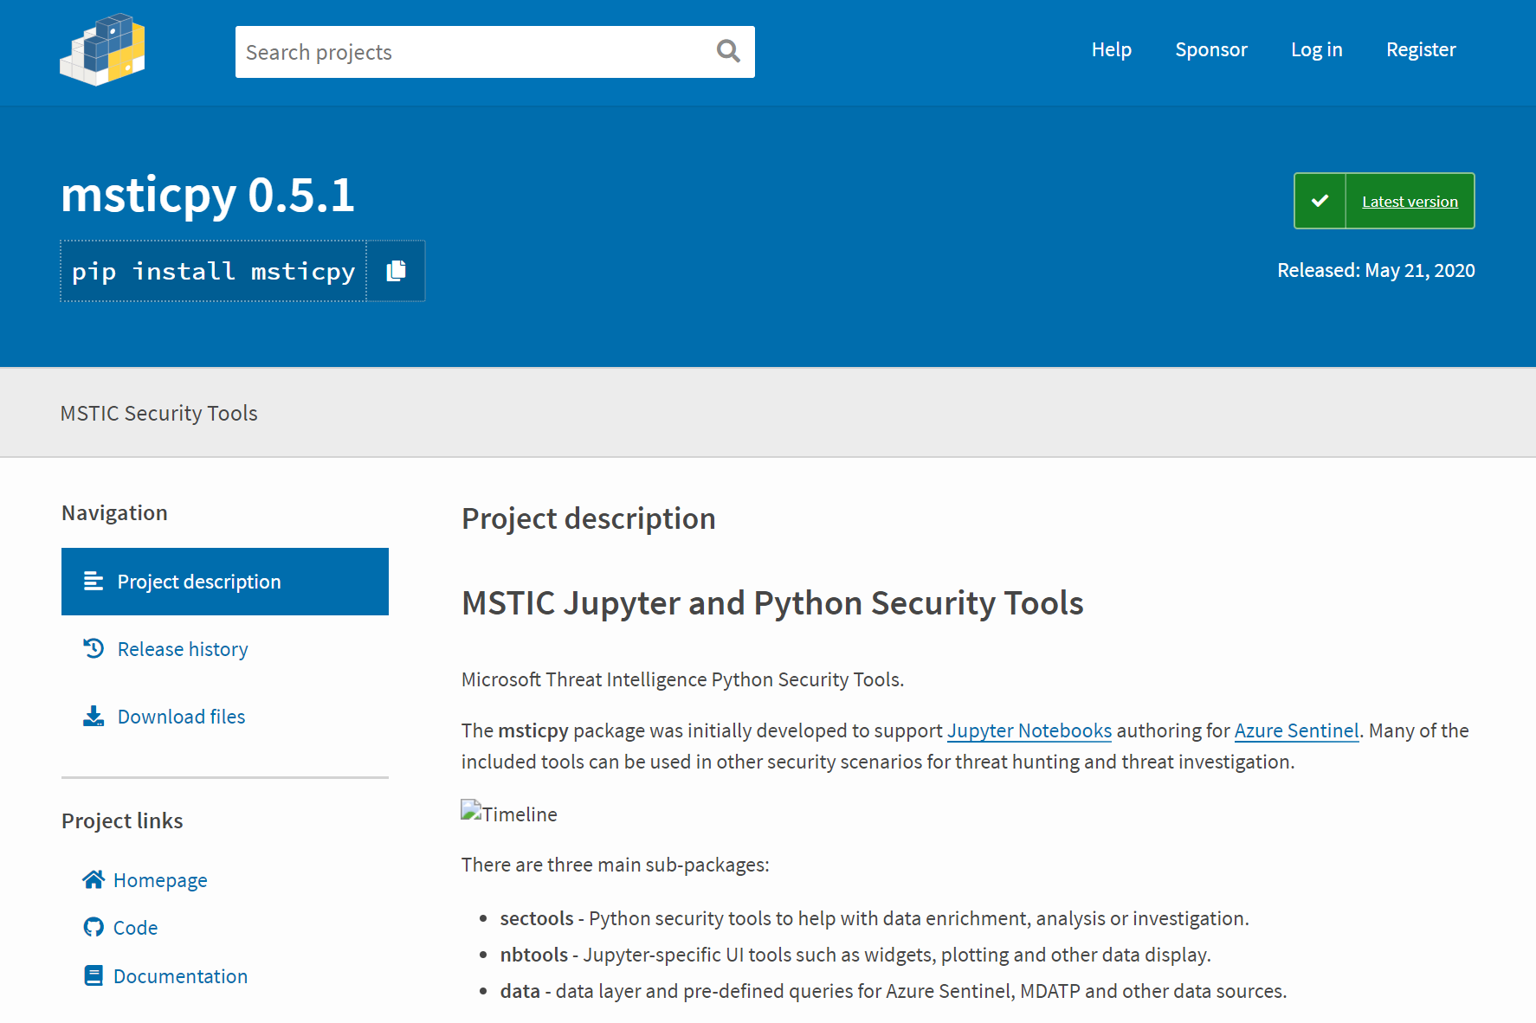
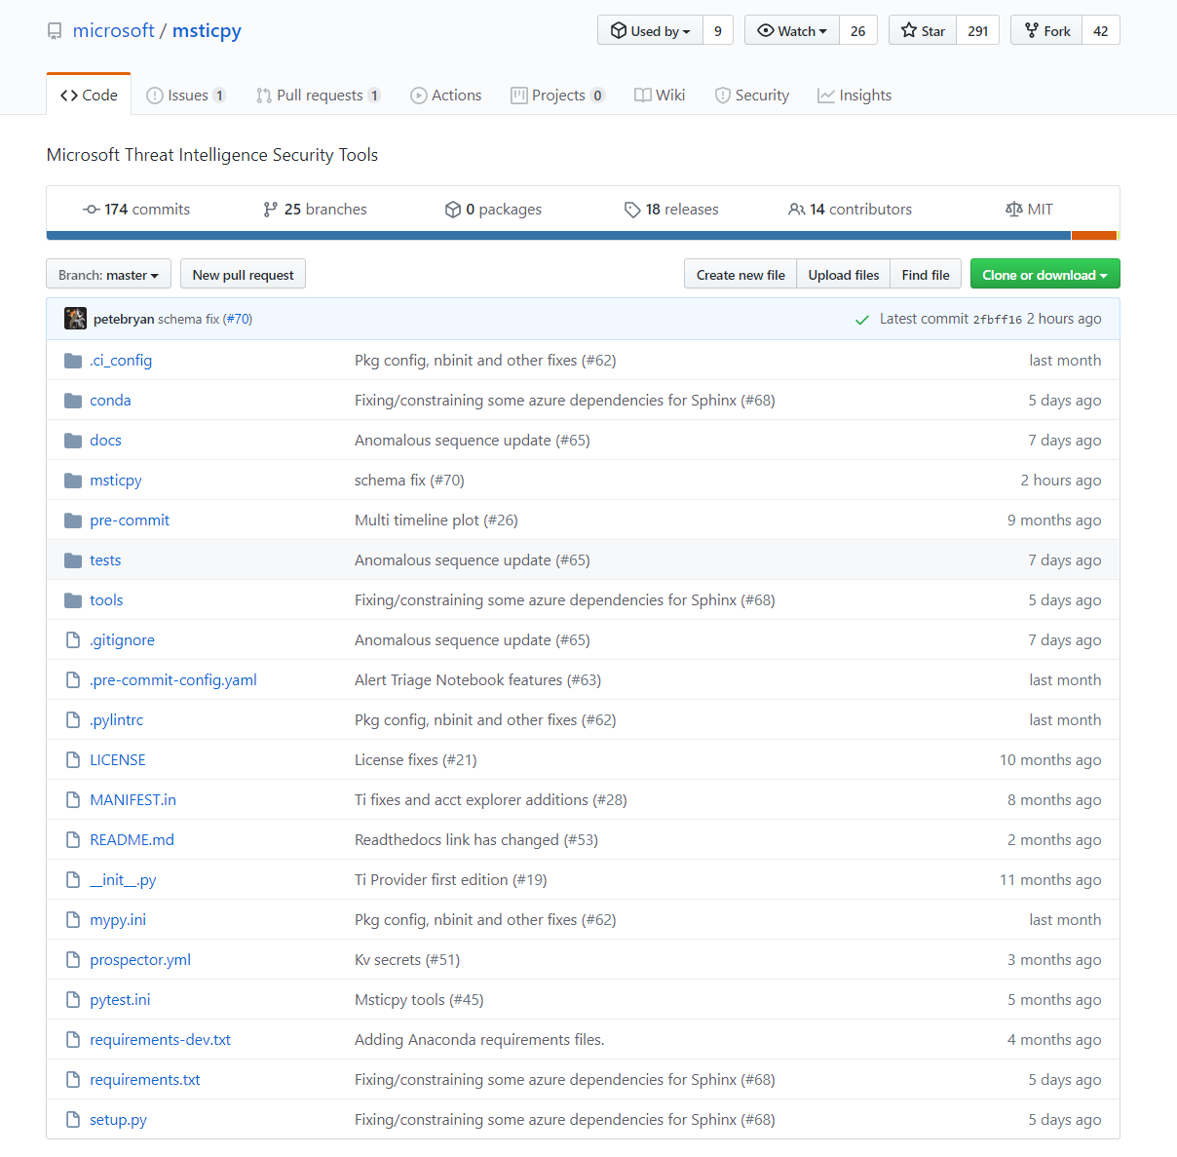
MSTIC Open Source Python Tools - #MSTICPy

Slide 21
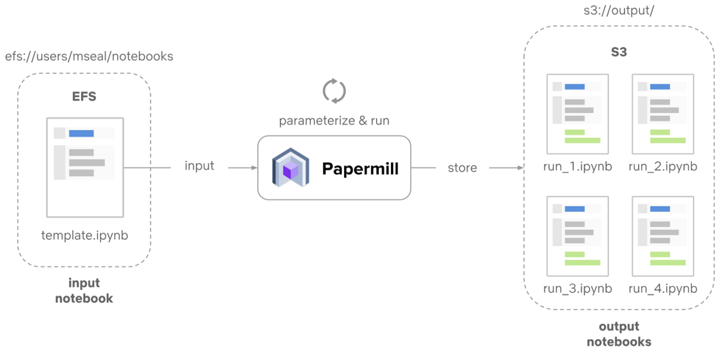
Scheduling Notebooks

Slide 22
Promoting Community

Slide 23
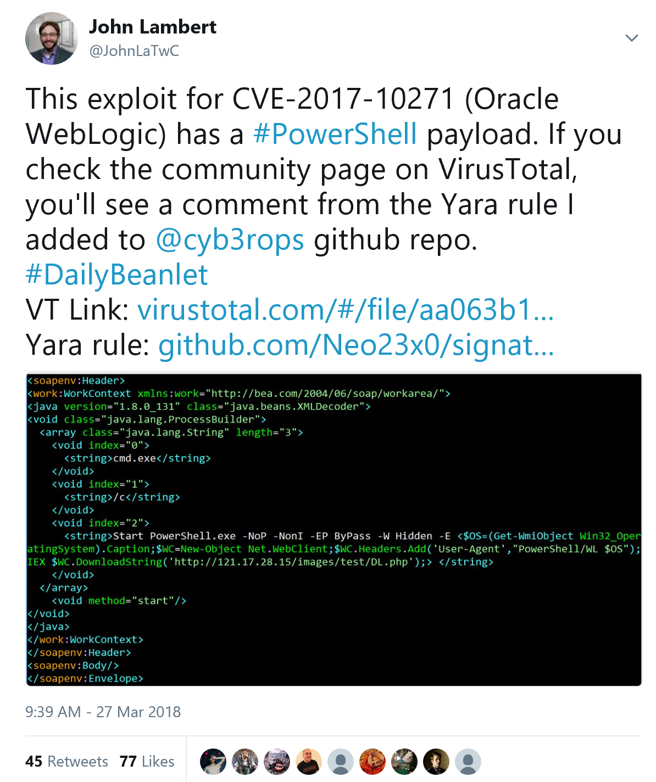
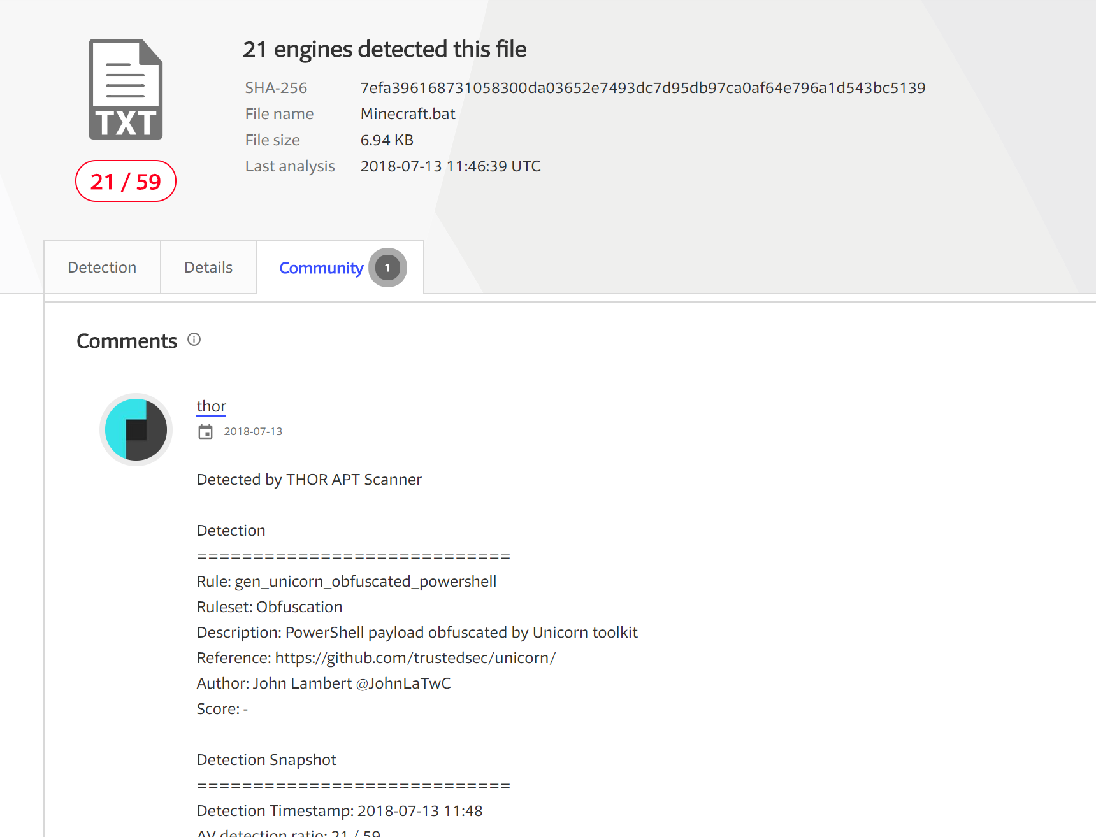
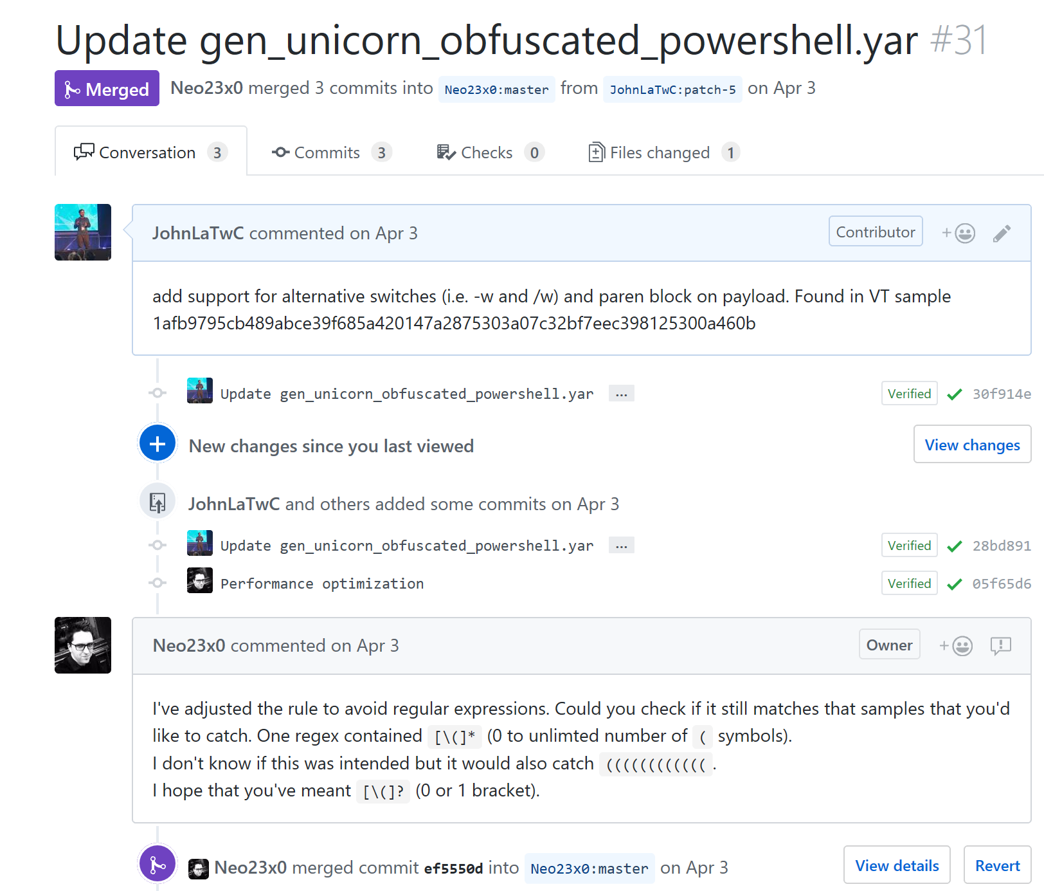
Community

Slide 24
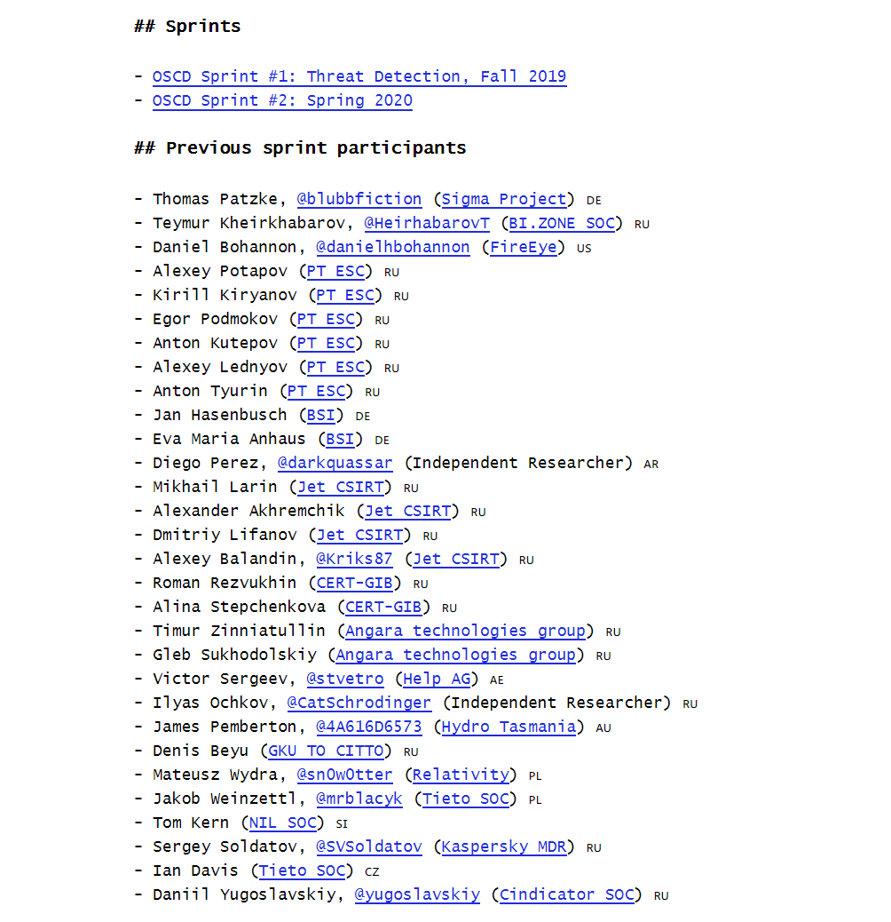
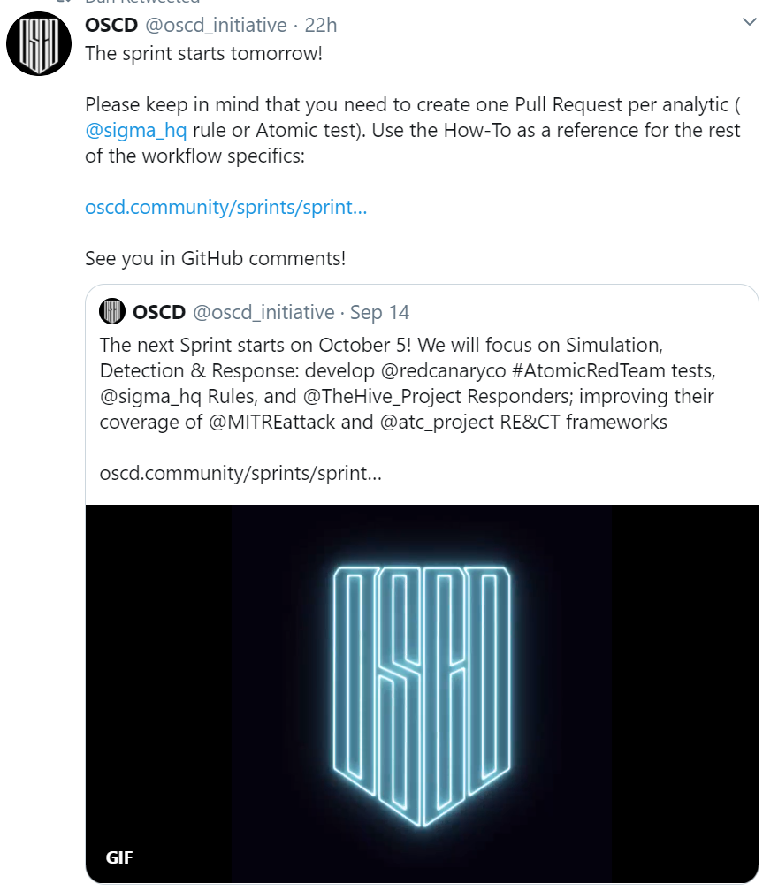


Slide 25





“Githubification” of Infosec
Threat Group
Technique Database
Detection Definitions
Detection Product
Repeatable Analysis

Slide 26
Getting started right away
If you’re a… | Try to:
Defender | Write and apply a Sigma rule Contribute a rule back to an open source repository Try out a Jupyter notebook on mybinder Take an online course on learning Python
Security Product Engineer | Support Sigma rules in your product such as JoeSecurity has done Publish a notebook that uses data from your product Support Python interfaces to your data
Security Researcher | Publish a notebook demonstrating a technique Contribute Sigma rules to a repository Add new attack techniques or examples to MITRE ATT&CK Publish data-sets useful for testing Sigma rules such as the MORDOR project.
InfoSec Manager | Ask a team member to research these technologies and share them with the team Ask peer companies if they have experience with ATT&CK, Sigma, or Jupyter notebooks Send your team members to training on Python or notebooks Use your voice as a customer to encourage vendors to support ATT&CK, Sigma, and Jupyter
Cyber security organization or CERT | Publish advisories with Sigma rules Reference MITRE ATT&CK techniques in advice and guidance

Slide 27
Further Resources
Blog: https://medium.com/@johnlatwc/the-githubification-of-infosec-afbdbfaad1d1
[RU]: https://habr.com/ru/company/microsoft/blog/487584/

